Slide 1
Chapter 10
Photosynthesis

Slide 2
Overview: The Process That Feeds the Biosphere
Photosynthesis is the process that converts solar energy into chemical energy
Directly or indirectly, photosynthesis nourishes almost the entire living world
Copyright © 2008 Pearson Education, Inc., publishing as Pearson Benjamin Cummings

Slide 3
Autotrophs sustain themselves without eating anything derived from other organisms
Autotrophs are the producers of the biosphere, producing organic molecules from CO₂ and other inorganic molecules
Almost all plants are photoautotrophs, using the energy of sunlight to make organic molecules from H₂O and CO₂
Copyright © 2008 Pearson Education, Inc., publishing as Pearson Benjamin Cummings

Slide 4
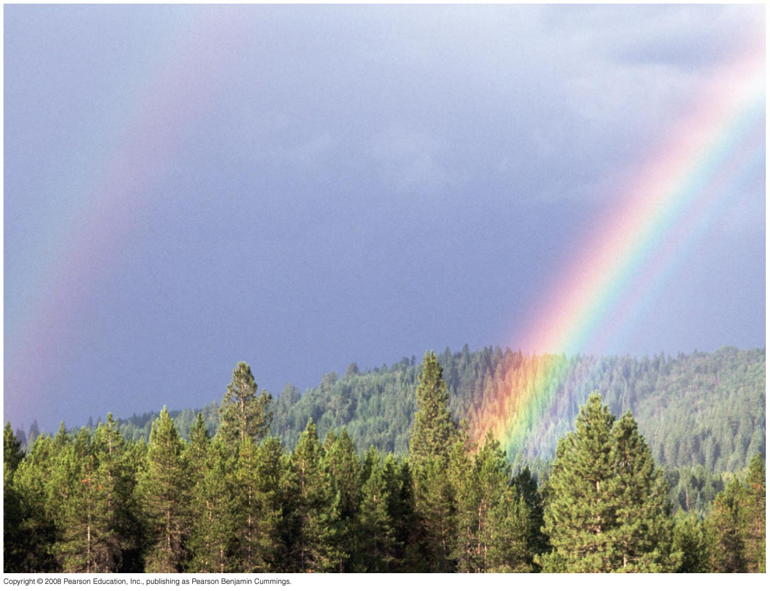
Fig. 10-1
Notes:
Figure 10.1 How can sunlight, seen here as a spectrum of colors in a rainbow, power the synthesis of organic substances?

Slide 5
Photosynthesis occurs in plants, algae, certain other protists, and some prokaryotes
These organisms feed not only themselves but also most of the living world
BioFlix: Photosynthesis
Copyright © 2008 Pearson Education, Inc., publishing as Pearson Benjamin Cummings

Slide 6
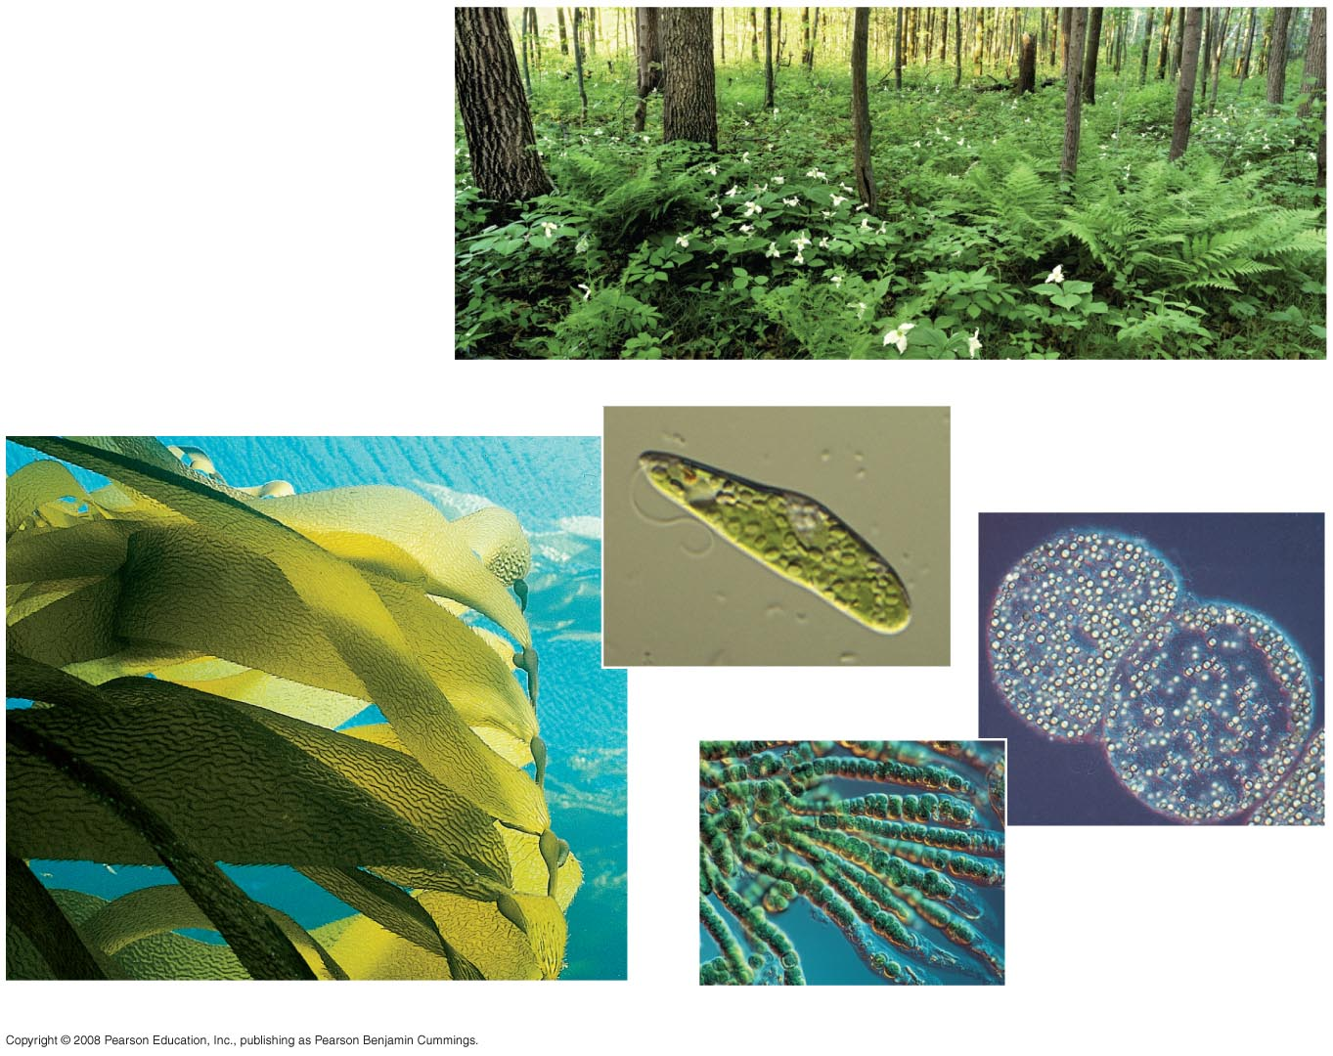
Fig. 10-2
(a) Plants
(c) Unicellular protist
10 µm
(e) Purple sulfur
bacteria
1.5 µm
(b) Multicellular alga
(d) Cyanobacteria
40 µm
Notes:
Figure 10.2 Photoautotrophs

Slide 7
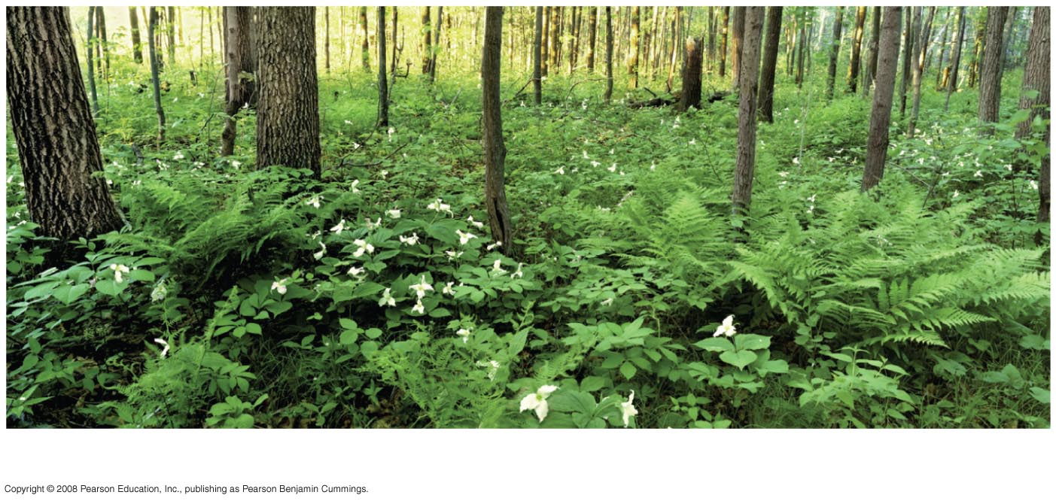
Fig. 10-2a
(a) Plants
Notes:
Figure 10.2 Photoautotrophs

Slide 8
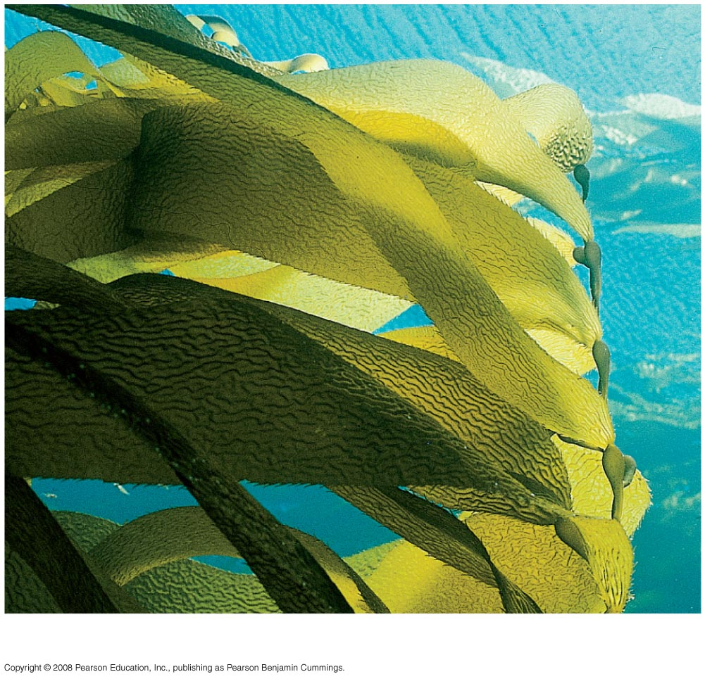
Fig. 10-2b
(b) Multicellular alga
Notes:
Figure 10.2 Photoautotrophs

Slide 9
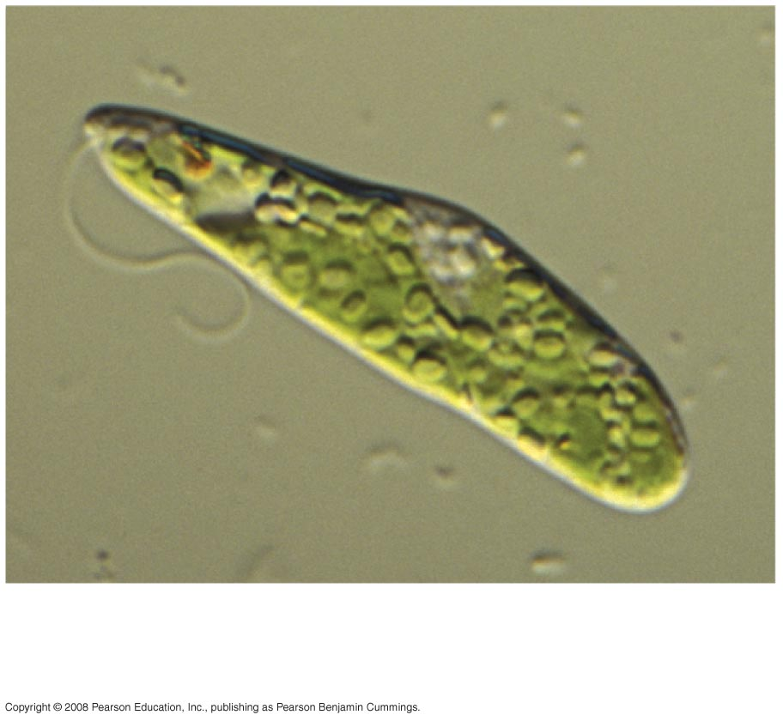
Fig. 10-2c
(c) Unicellular protist
10 µm
Notes:
Figure 10.2 Photoautotrophs

Slide 10
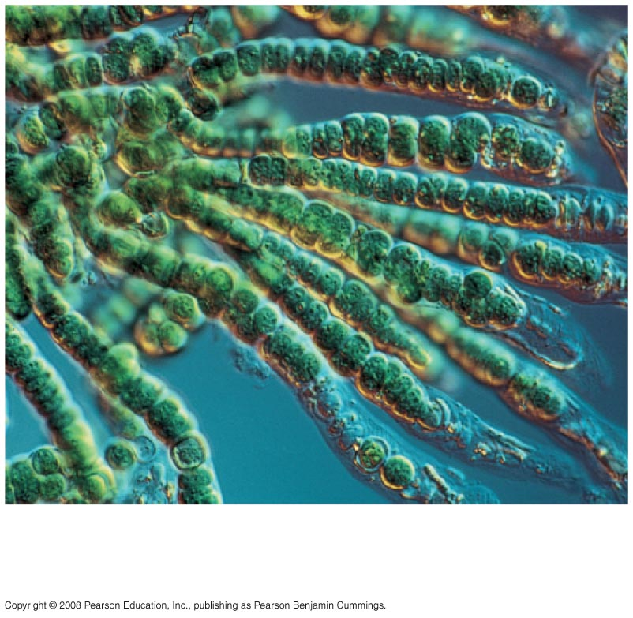
Fig. 10-2d
(d) Cyanobacteria
40 µm
Notes:
Figure 10.2 Photoautotrophs

Slide 11
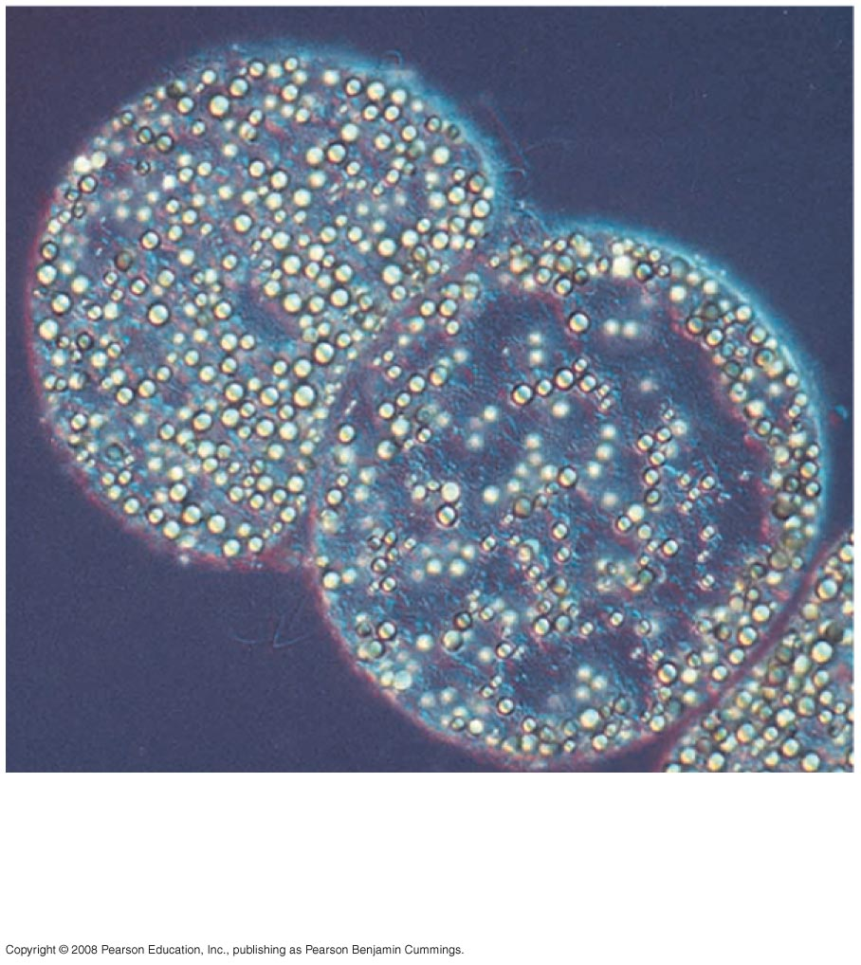
Fig. 10-2e
(e) Purple sulfur
bacteria
1.5 µm
Notes:
Figure 10.2 Photoautotrophs

Slide 12
Heterotrophs obtain their organic material from other organisms
Heterotrophs are the consumers of the biosphere
Almost all heterotrophs, including humans, depend on photoautotrophs for food and O₂
Copyright © 2008 Pearson Education, Inc., publishing as Pearson Benjamin Cummings

Slide 13
Concept 10.1: Photosynthesis converts light energy to the chemical energy of food
Chloroplasts are structurally similar to and likely evolved from photosynthetic bacteria
The structural organization of these cells allows for the chemical reactions of photosynthesis
Copyright © 2008 Pearson Education, Inc., publishing as Pearson Benjamin Cummings

Slide 14
Chloroplasts: The Sites of Photosynthesis in Plants
Leaves are the major locations of photosynthesis
Their green color is from chlorophyll, the green pigment within chloroplasts
Light energy absorbed by chlorophyll drives the synthesis of organic molecules in the chloroplast
CO₂ enters and O₂ exits the leaf through microscopic pores called stomata
Copyright © 2008 Pearson Education, Inc., publishing as Pearson Benjamin Cummings

Slide 15
Chloroplasts are found mainly in cells of the mesophyll, the interior tissue of the leaf
A typical mesophyll cell has 30–40 chloroplasts
The chlorophyll is in the membranes of thylakoids (connected sacs in the chloroplast); thylakoids may be stacked in columns called grana
Chloroplasts also contain stroma, a dense fluid
Copyright © 2008 Pearson Education, Inc., publishing as Pearson Benjamin Cummings

Slide 16
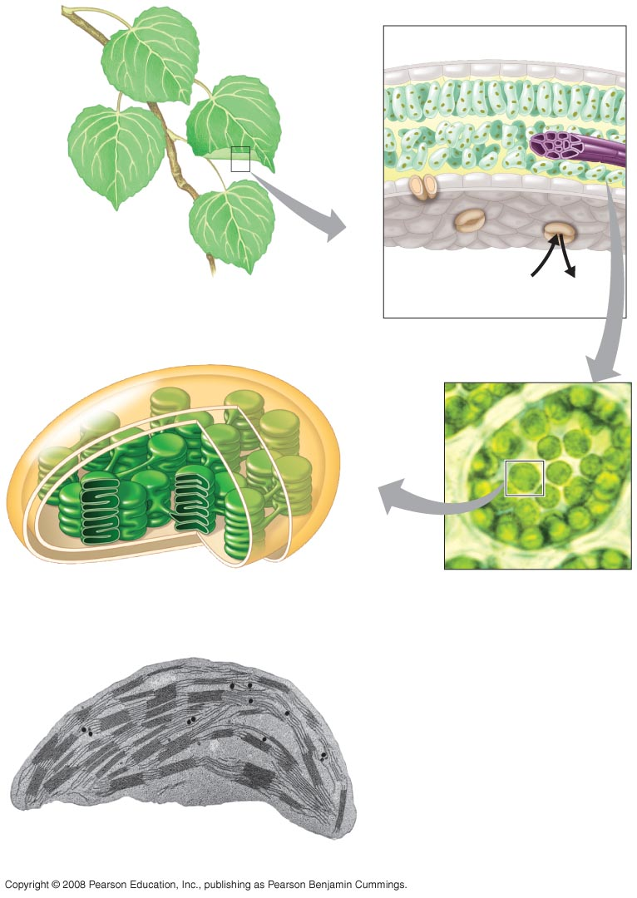
Fig. 10-3
Leaf cross section
Vein
Mesophyll
Stomata
CO₂
O₂
Chloroplast
Mesophyll cell
Outer
membrane
Thylakoid
Intermembrane
space
5 µm
Stroma
Granum
Thylakoid
space
Inner
membrane
1 µm
Notes:
Figure 10.3 Zooming in on the location of photosynthesis in a plant

Slide 17
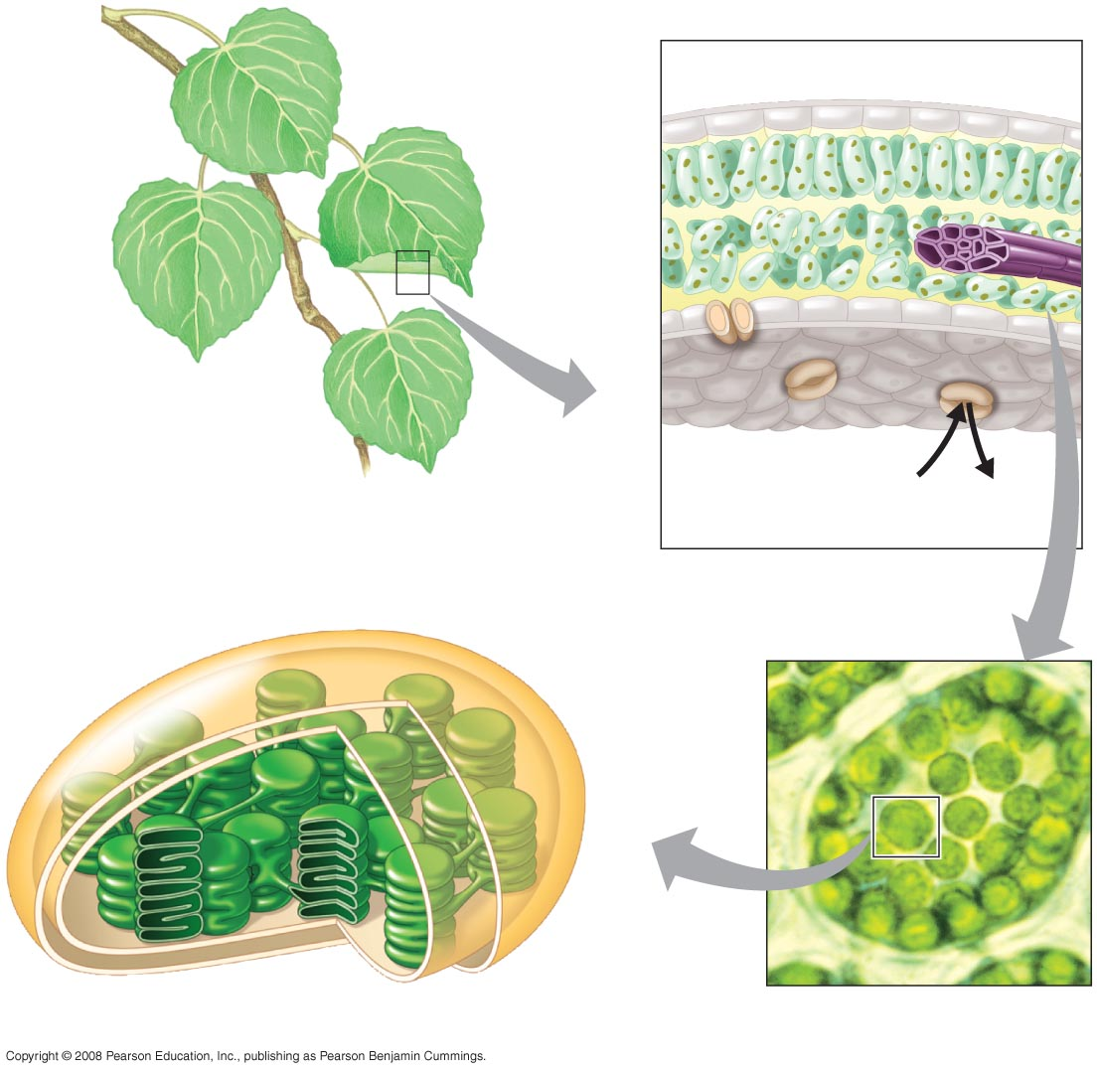
Fig. 10-3a
Leaf cross section
Vein
Mesophyll
Stomata
CO₂
O₂
Chloroplast
Mesophyll cell
5 µm
Notes:
Figure 10.3 Zooming in on the location of photosynthesis in a plant

Slide 18
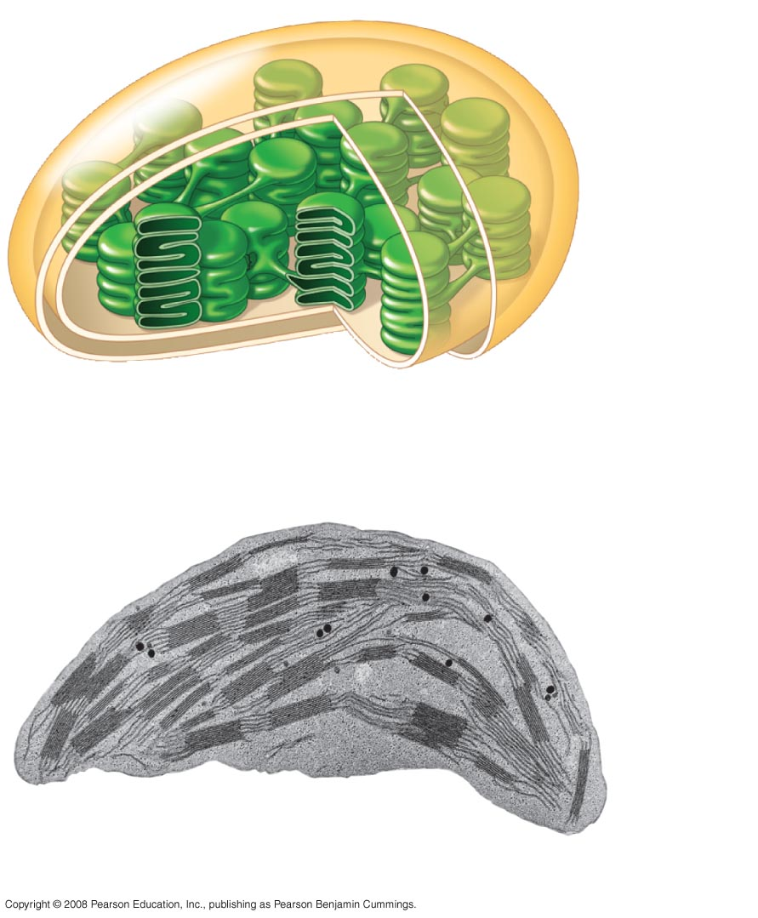
Fig. 10-3b
Chloroplast
Outer
membrane
Thylakoid
Intermembrane
space
Stroma
Granum
Thylakoid
space
Inner
membrane
1 µm
Notes:
Figure 10.3 Zooming in on the location of photosynthesis in a plant

Slide 19
Tracking Atoms Through Photosynthesis: Scientific Inquiry
Photosynthesis can be summarized as the following equation:
6 CO₂ + 12 H₂O + Light energy → C₆H₁₂O₆ + 6 O₂ + 6 H₂O
Copyright © 2008 Pearson Education, Inc., publishing as Pearson Benjamin Cummings

Slide 20
The Splitting of Water
Chloroplasts split H₂O into hydrogen and oxygen, incorporating the electrons of hydrogen into sugar molecules
Copyright © 2008 Pearson Education, Inc., publishing as Pearson Benjamin Cummings

Slide 21
Fig. 10-4
Reactants:
6 CO₂
12 H₂O
Products:
C₆H₁₂O₆
6 H₂O
6 O₂
Notes:
Figure 10.4 Tracking atoms through photosynthesis

Slide 22
Photosynthesis as a Redox Process
Photosynthesis is a redox process in which H₂O is oxidized and CO₂ is reduced
Copyright © 2008 Pearson Education, Inc., publishing as Pearson Benjamin Cummings

Slide 23
The Two Stages of Photosynthesis: A Preview
Photosynthesis consists of the light reactions (the photo part) and Calvin cycle (the synthesis part)
The light reactions (in the thylakoids):
Split H₂O
Release O₂
Reduce NADP⁺ to NADPH
Generate ATP from ADP by photophosphorylation
Copyright © 2008 Pearson Education, Inc., publishing as Pearson Benjamin Cummings

Slide 24
The Calvin cycle (in the stroma) forms sugar from CO₂, using ATP and NADPH
The Calvin cycle begins with carbon fixation, incorporating CO₂ into organic molecules
Copyright © 2008 Pearson Education, Inc., publishing as Pearson Benjamin Cummings

Slide 25
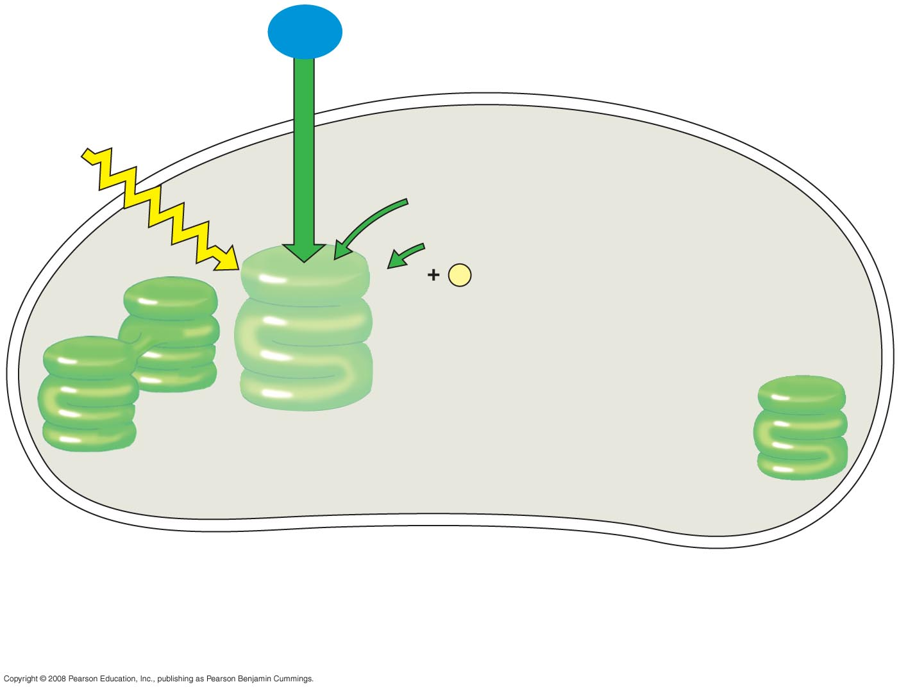
Fig. 10-5-1
H₂O
Light
NADP⁺
ADP
+
P
_{i}
Light
Reactions
Chloroplast
Notes:
Figure 10.5 An overview of photosynthesis: cooperation of the light reactions and the Calvin cycle

Slide 26
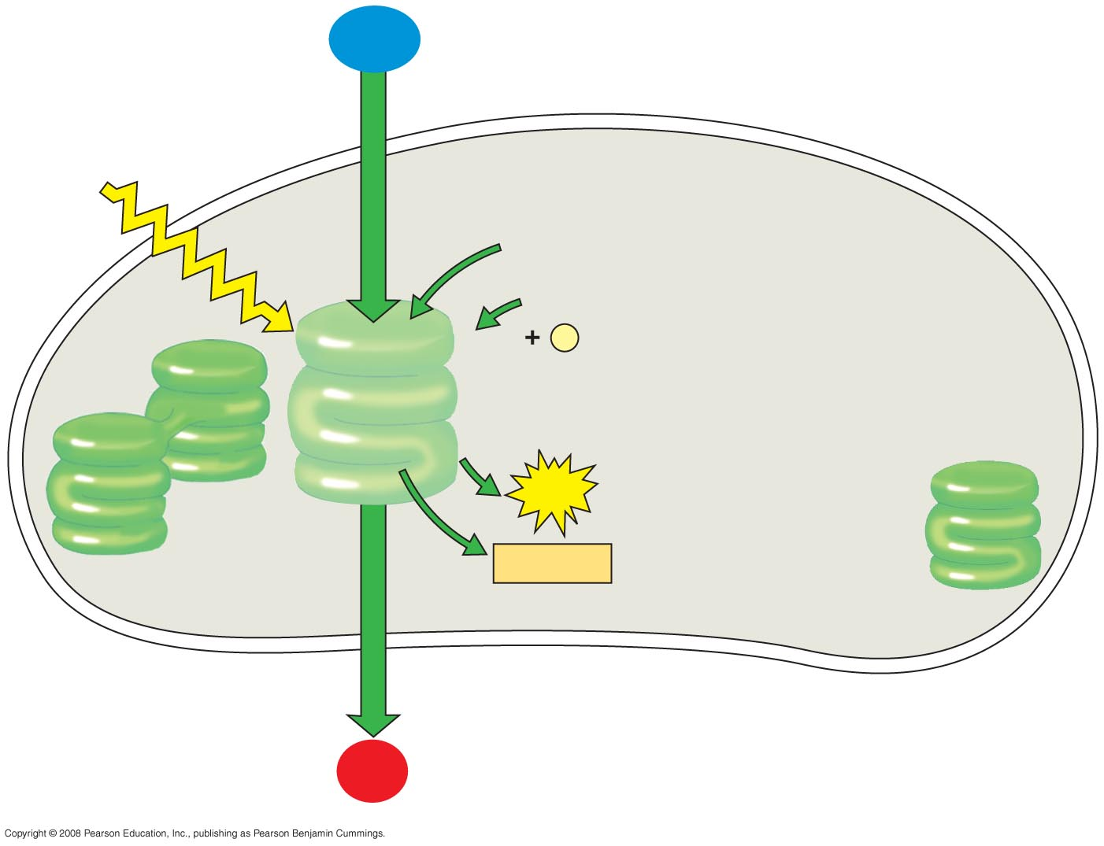
Fig. 10-5-2
H₂O
Light
NADP⁺
ADP
+
P
_{i}
Light
Reactions
ATP
NADPH
Chloroplast
O₂
Notes:
Figure 10.5 An overview of photosynthesis: cooperation of the light reactions and the Calvin cycle

Slide 27
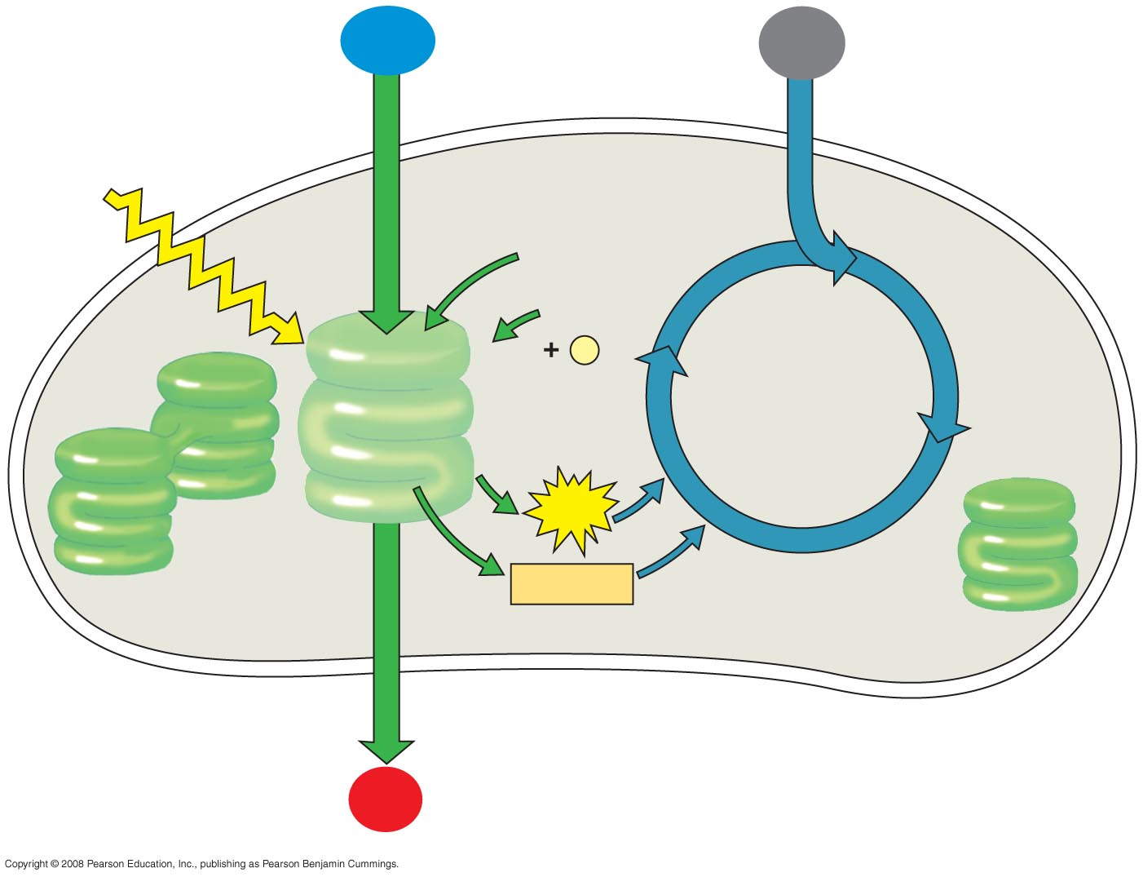
Fig. 10-5-3
H₂O
CO₂
Light
NADP⁺
ADP
+
P
_{i}
Calvin
Cycle
Light
Reactions
ATP
NADPH
Chloroplast
O₂
Notes:
Figure 10.5 An overview of photosynthesis: cooperation of the light reactions and the Calvin cycle

Slide 28
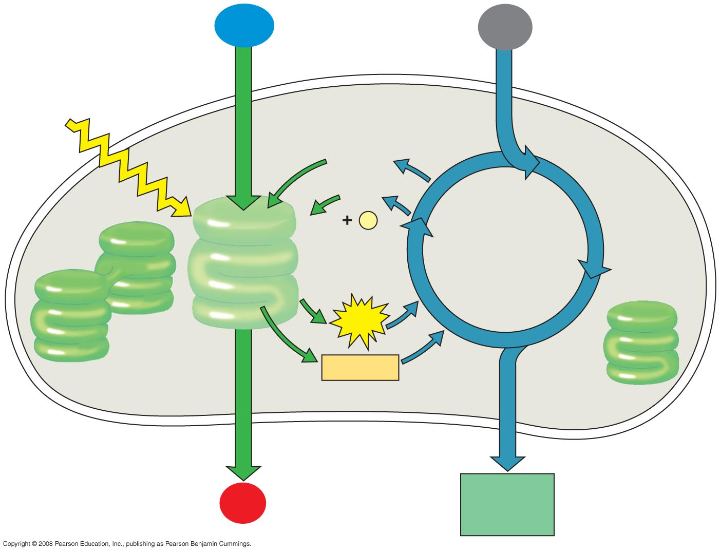
Fig. 10-5-4
H₂O
CO₂
Light
NADP⁺
ADP
+
P
_{i}
Calvin
Cycle
Light
Reactions
ATP
NADPH
Chloroplast
O₂
[CH₂O]
(sugar)
Notes:
Figure 10.5 An overview of photosynthesis: cooperation of the light reactions and the Calvin cycle

Slide 29
Concept 10.2: The light reactions convert solar energy to the chemical energy of ATP and NADPH
Chloroplasts are solar-powered chemical factories
Their thylakoids transform light energy into the chemical energy of ATP and NADPH
Copyright © 2008 Pearson Education, Inc., publishing as Pearson Benjamin Cummings

Slide 30
The Nature of Sunlight
Light is a form of electromagnetic energy, also called electromagnetic radiation
Like other electromagnetic energy, light travels in rhythmic waves
Wavelength is the distance between crests of waves
Wavelength determines the type of electromagnetic energy
Copyright © 2008 Pearson Education, Inc., publishing as Pearson Benjamin Cummings

Slide 31
The electromagnetic spectrum is the entire range of electromagnetic energy, or radiation
Visible light consists of wavelengths (including those that drive photosynthesis) that produce colors we can see
Light also behaves as though it consists of discrete particles, called photons
Copyright © 2008 Pearson Education, Inc., publishing as Pearson Benjamin Cummings

Slide 32
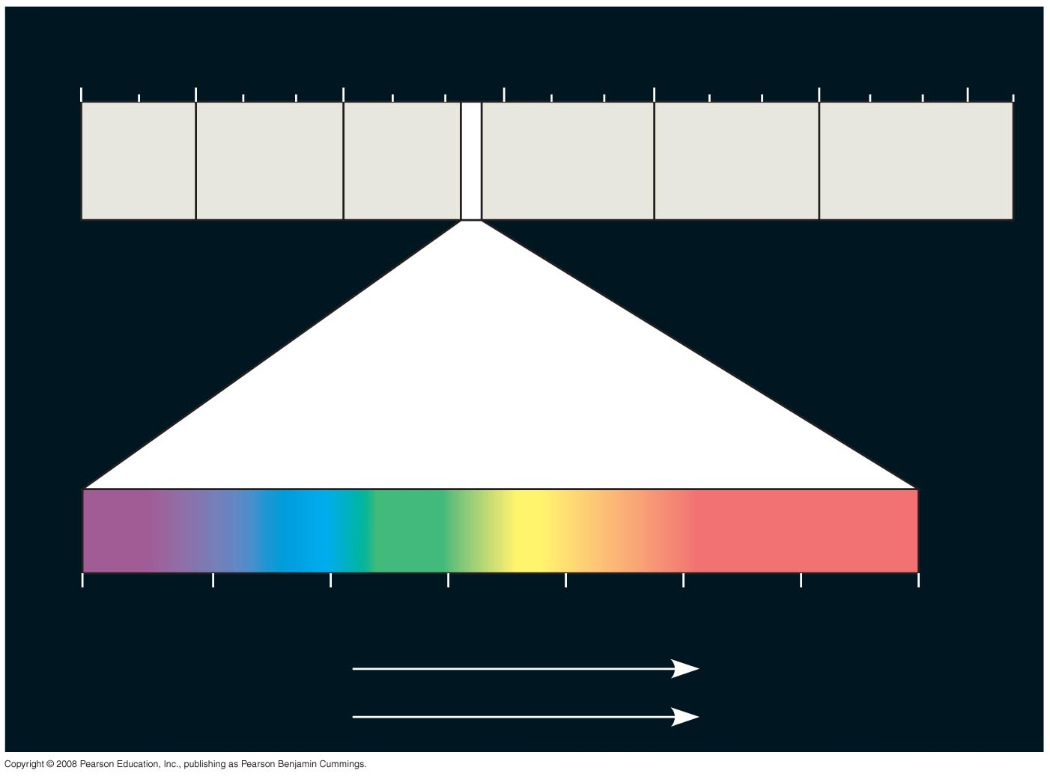
Fig. 10-6
1 m
(10⁹ nm)
10^{–5} nm
10^{–3} nm
1 nm
10³ nm
10⁶ nm
10³ m
Gamma
rays
Micro-
waves
Radio
waves
X-rays
UV
Infrared
Visible light
380
450
500
550
600
650
700
750 nm
Shorter wavelength
Longer wavelength
Higher energy
Lower energy
Notes:
Figure 10.6 The electromagnetic spectrum

Slide 33
Photosynthetic Pigments: The Light Receptors
Pigments are substances that absorb visible light
Different pigments absorb different wavelengths
Wavelengths that are not absorbed are reflected or transmitted
Leaves appear green because chlorophyll reflects and transmits green light
Animation: Light and Pigments
Copyright © 2008 Pearson Education, Inc., publishing as Pearson Benjamin Cummings

Slide 34
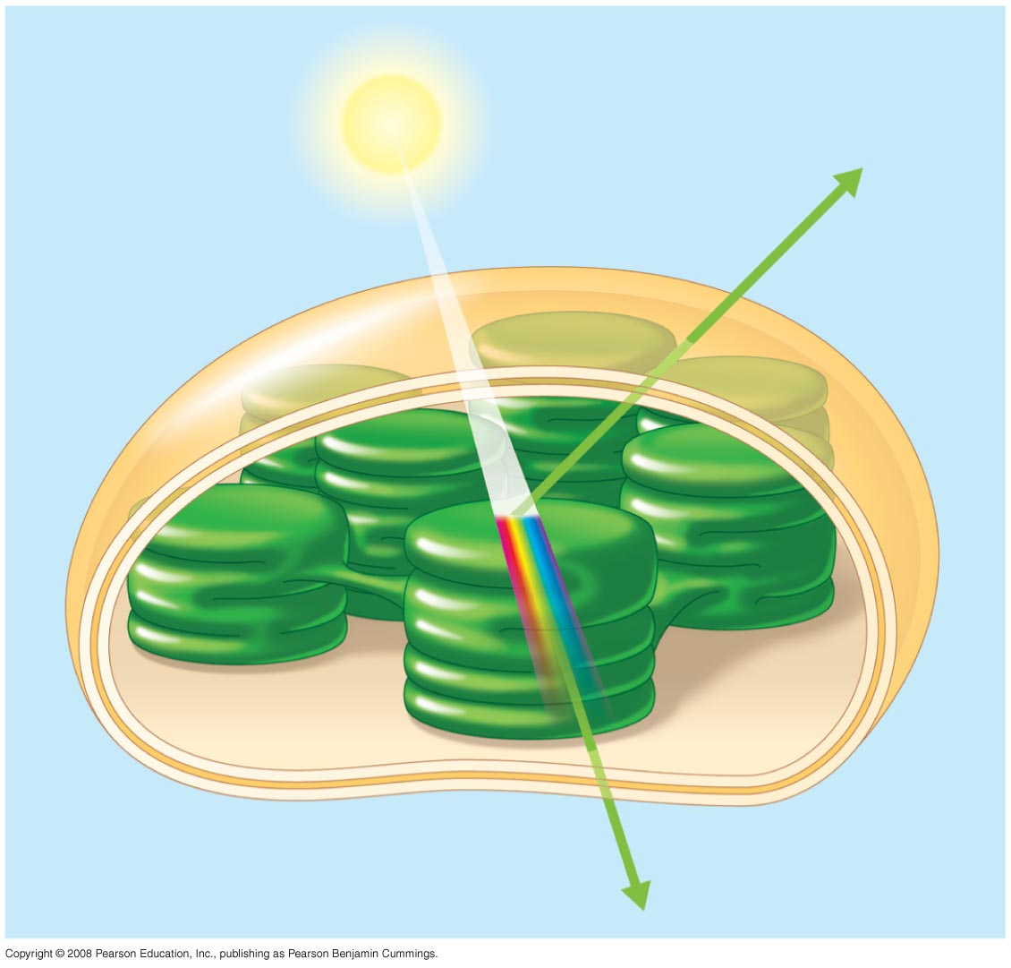
Fig. 10-7
Light
Reflected
light
Chloroplast
Absorbed
light
Granum
Transmitted
light
Notes:
Figure 10.7 Why leaves are green: interaction of light with chloroplasts

Slide 35
A spectrophotometer measures a pigment’s ability to absorb various wavelengths
This machine sends light through pigments and measures the fraction of light transmitted at each wavelength
Copyright © 2008 Pearson Education, Inc., publishing as Pearson Benjamin Cummings

Slide 36
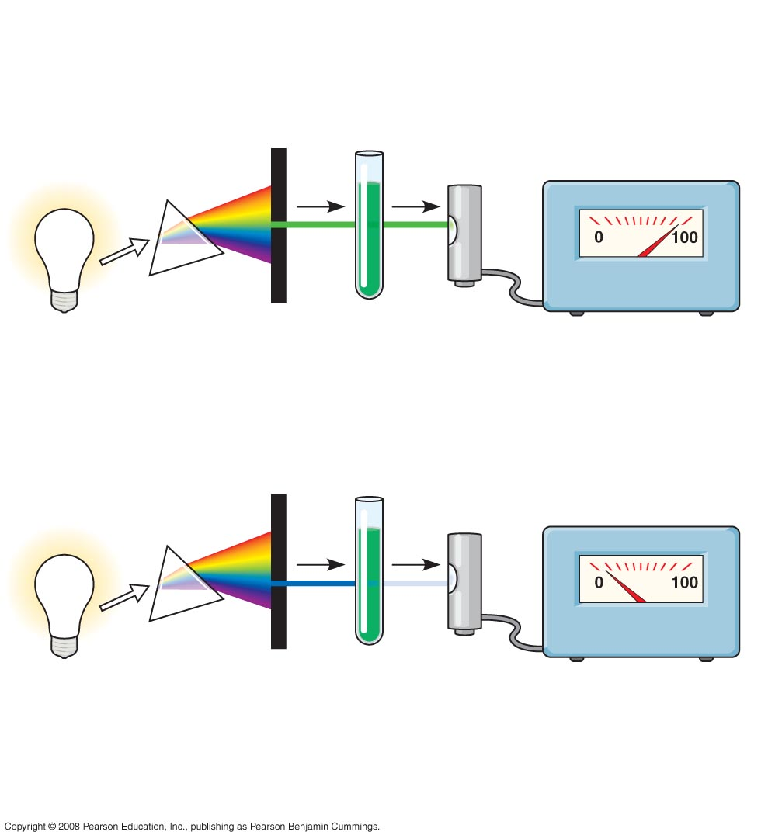
Fig. 10-8
TECHNIQUE
White
light
Refracting
prism
Chlorophyll
solution
Photoelectric
tube
Galvanometer
2
3
1
4
The high transmittance
(low absorption)
reading indicates that
chlorophyll absorbs
very little green light.
Slit moves to
pass light
of selected
wavelength
Green
light
The low transmittance
(high absorption)
reading indicates that
chlorophyll absorbs
most blue light.
Blue
light
Notes:
Figure 10.8 Determining an absorption spectrum

Slide 37
An absorption spectrum is a graph plotting a pigment’s light absorption versus wavelength
The absorption spectrum of chlorophyll a suggests that violet-blue and red light work best for photosynthesis
An action spectrum profiles the relative effectiveness of different wavelengths of radiation in driving a process
Copyright © 2008 Pearson Education, Inc., publishing as Pearson Benjamin Cummings
Notes:
For the Cell Biology Video Space-Filling Model of Chlorophyll a, go to Animation and Video Files.

Slide 38
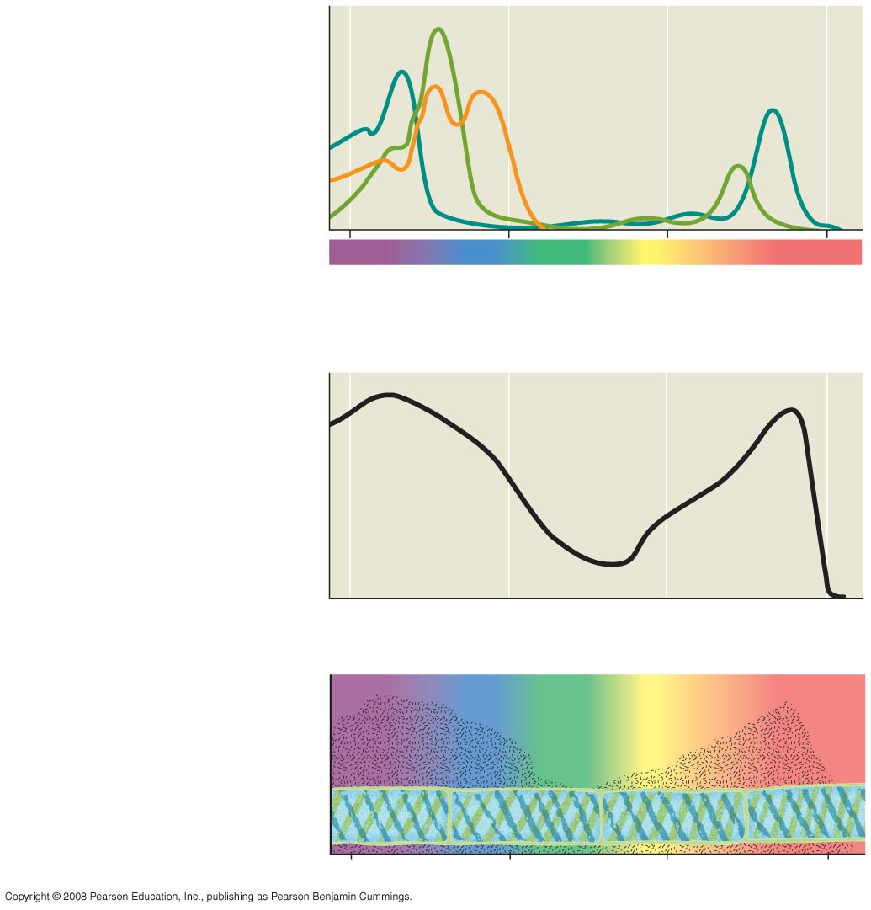
Fig. 10-9
RESULTS
Chloro-
phyll a
Chlorophyll b
Absorption of light by
chloroplast pigments
Carotenoids
(a) Absorption spectra
400
500
600
700
Wavelength of light (nm)
Rate of photosynthesis
(measured by O₂ release)
(b) Action spectrum
Aerobic bacteria
Filament
of alga
(c) Engelmann’s
experiment
400
500
600
700
Notes:
Figure 10.9 Which wavelengths of light are most effective in driving photosynthesis?

Slide 39
The action spectrum of photosynthesis was first demonstrated in 1883 by Theodor W. Engelmann
In his experiment, he exposed different segments of a filamentous alga to different wavelengths
Areas receiving wavelengths favorable to photosynthesis produced excess O₂
He used the growth of aerobic bacteria clustered along the alga as a measure of O₂ production
Copyright © 2008 Pearson Education, Inc., publishing as Pearson Benjamin Cummings

Slide 40
Chlorophyll a is the main photosynthetic pigment
Accessory pigments, such as chlorophyll b, broaden the spectrum used for photosynthesis
Accessory pigments called carotenoids absorb excessive light that would damage chlorophyll
Copyright © 2008 Pearson Education, Inc., publishing as Pearson Benjamin Cummings

Slide 41
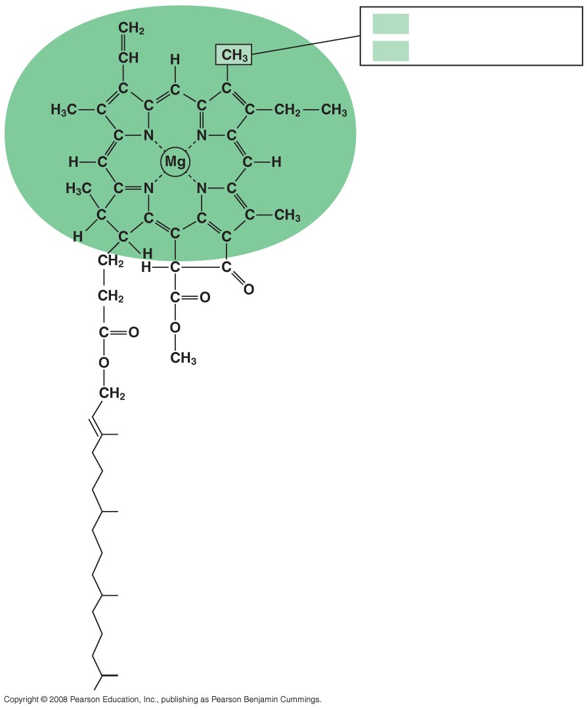
Fig. 10-10
CH₃
in chlorophyll a
CHO
in chlorophyll b
Porphyrin ring:
light-absorbing
“head” of molecule;
note magnesium
atom at center
Hydrocarbon tail:
interacts with hydrophobic
regions of proteins inside
thylakoid membranes of
chloroplasts; H atoms not
shown
Notes:
Figure 10.10 Structure of chlorophyll molecules in chloroplasts of plants

Slide 42
Excitation of Chlorophyll by Light
When a pigment absorbs light, it goes from a ground state to an excited state, which is unstable
When excited electrons fall back to the ground state, photons are given off, an afterglow called fluorescence
If illuminated, an isolated solution of chlorophyll will fluoresce, giving off light and heat
Copyright © 2008 Pearson Education, Inc., publishing as Pearson Benjamin Cummings

Slide 43
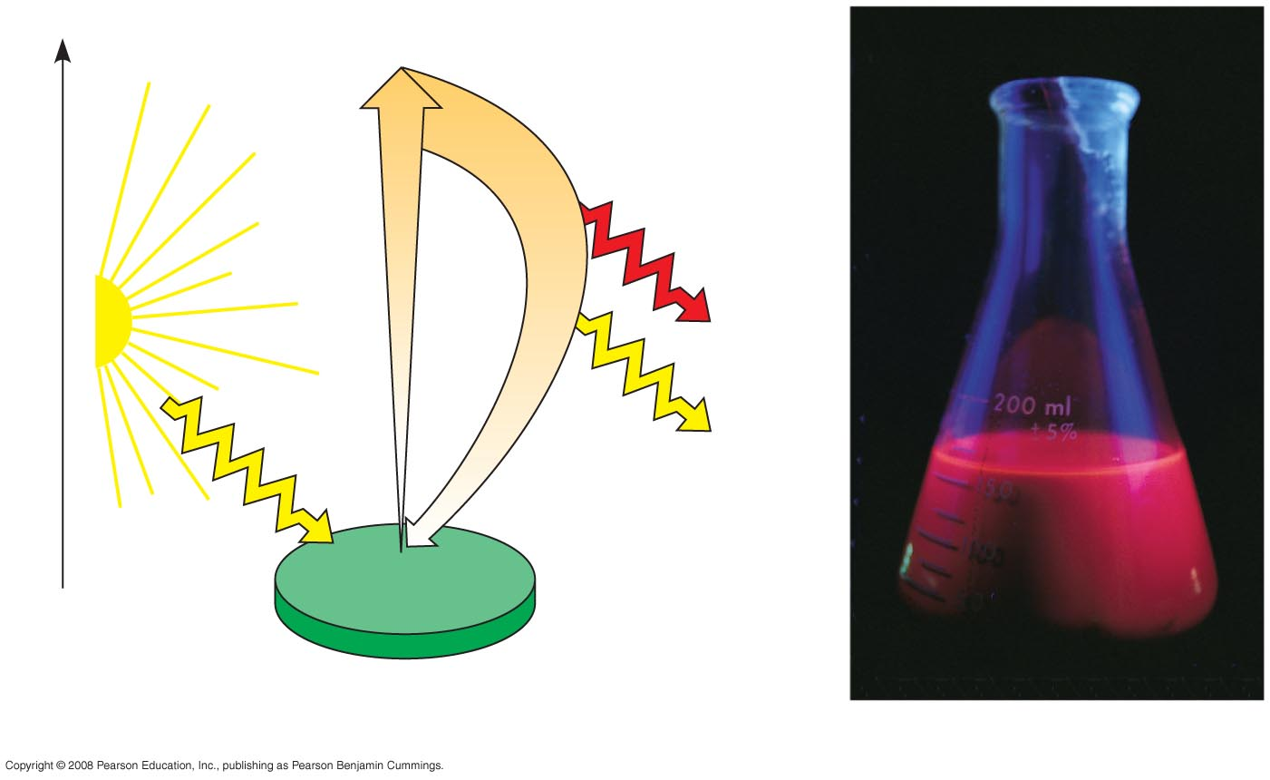
Fig. 10-11
Excited
state
e–
Heat
Energy of electron
Photon
(fluorescence)
Photon
Ground
state
Chlorophyll
molecule
(a) Excitation of isolated chlorophyll molecule
(b) Fluorescence
Notes:
Figure 10.11 Excitation of isolated chlorophyll by light

Slide 44
A Photosystem: A Reaction-Center Complex Associated with Light-Harvesting Complexes
A photosystem consists of a reaction-center complex (a type of protein complex) surrounded by light-harvesting complexes
The light-harvesting complexes (pigment molecules bound to proteins) funnel the energy of photons to the reaction center
Copyright © 2008 Pearson Education, Inc., publishing as Pearson Benjamin Cummings

Slide 45
A primary electron acceptor in the reaction center accepts an excited electron from chlorophyll a
Solar-powered transfer of an electron from a chlorophyll a molecule to the primary electron acceptor is the first step of the light reactions
Copyright © 2008 Pearson Education, Inc., publishing as Pearson Benjamin Cummings

Slide 46
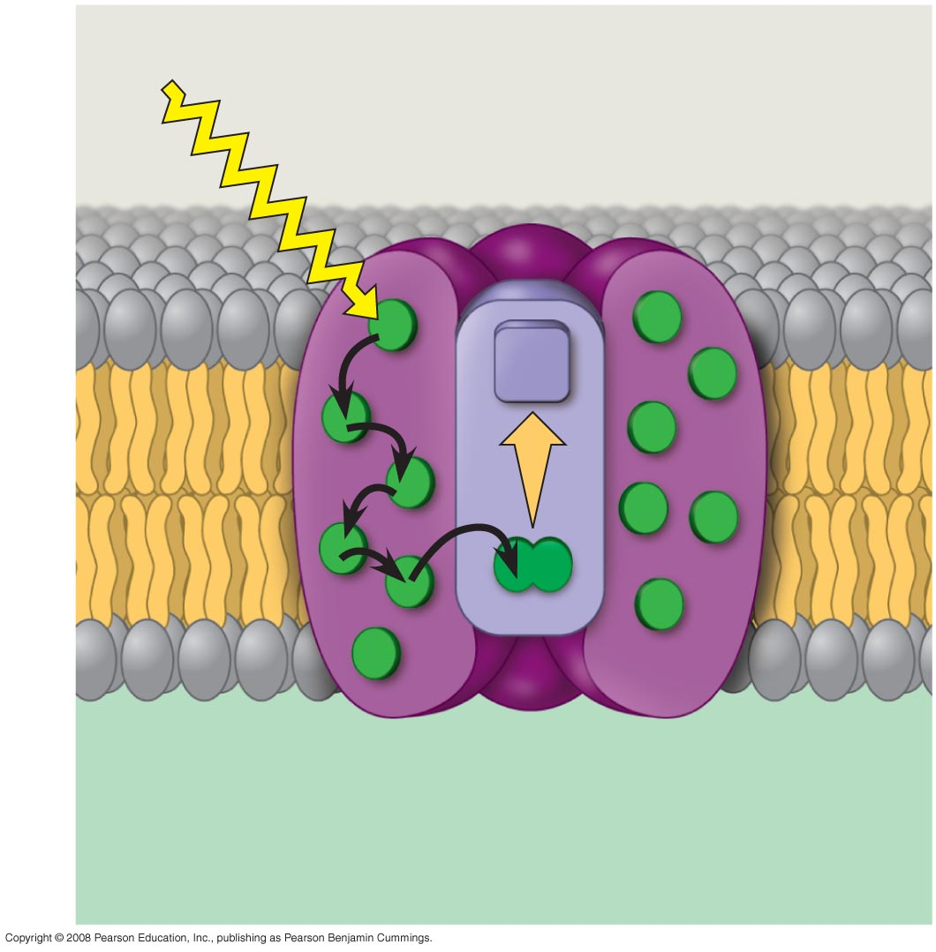
Fig. 10-12
Photosystem
STROMA
Photon
Light-harvesting
complexes
Reaction-center
complex
Primary
electron
acceptor
e–
Thylakoid membrane
Transfer
of energy
Special pair of
chlorophyll a
molecules
Pigment
molecules
THYLAKOID SPACE
(INTERIOR OF THYLAKOID)
Notes:
Figure 10.12 How a photosystem harvests light

Slide 47
There are two types of photosystems in the thylakoid membrane
Photosystem II (PS II) functions first (the numbers reflect order of discovery) and is best at absorbing a wavelength of 680 nm
The reaction-center chlorophyll a of PS II is called P680
Copyright © 2008 Pearson Education, Inc., publishing as Pearson Benjamin Cummings

Slide 48
Photosystem I (PS I) is best at absorbing a wavelength of 700 nm
The reaction-center chlorophyll a of PS I is called P700
Copyright © 2008 Pearson Education, Inc., publishing as Pearson Benjamin Cummings

Slide 49
Linear Electron Flow
During the light reactions, there are two possible routes for electron flow: cyclic and linear
Linear electron flow, the primary pathway, involves both photosystems and produces ATP and NADPH using light energy
Copyright © 2008 Pearson Education, Inc., publishing as Pearson Benjamin Cummings

Slide 50
A photon hits a pigment and its energy is passed among pigment molecules until it excites P680
An excited electron from P680 is transferred to the primary electron acceptor
Copyright © 2008 Pearson Education, Inc., publishing as Pearson Benjamin Cummings

Slide 51
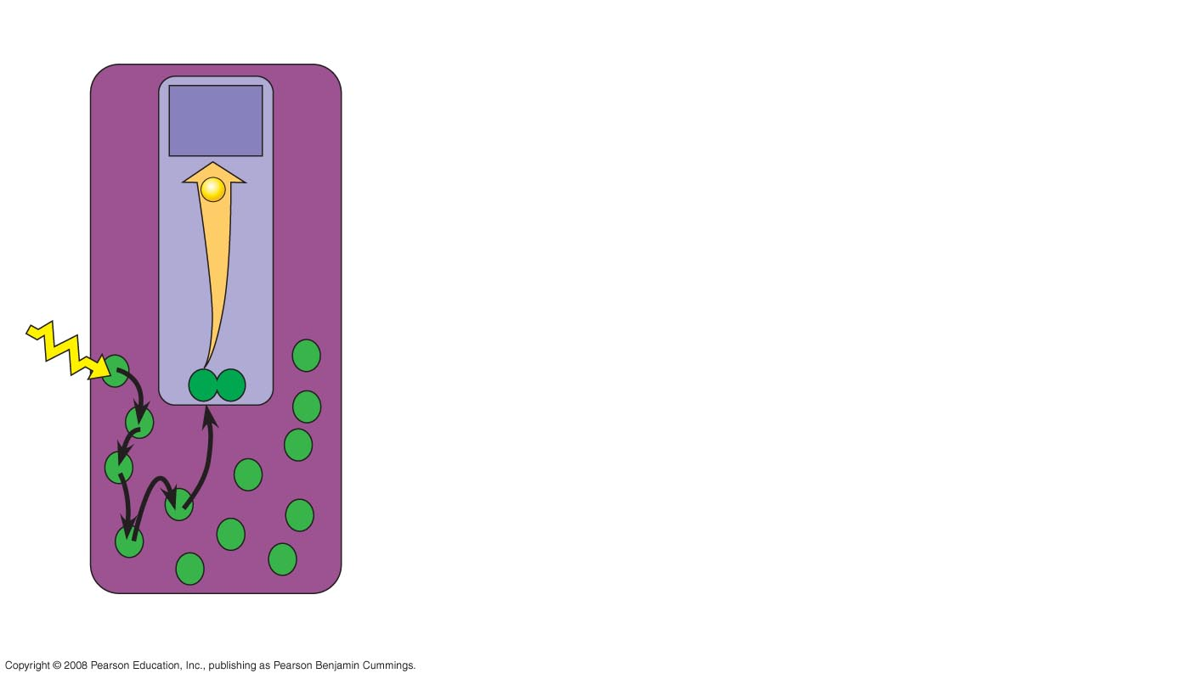
Fig. 10-13-1
Primary
acceptor
2
e–
P680
1
Light
Pigment
molecules
Photosystem II
(PS II)
Notes:
Figure 10.13 How linear electron flow during the light reactions generates ATP and NADPH

Slide 52
P680⁺ (P680 that is missing an electron) is a very strong oxidizing agent
H₂O is split by enzymes, and the electrons are transferred from the hydrogen atoms to P680⁺, thus reducing it to P680
O₂ is released as a by-product of this reaction
Copyright © 2008 Pearson Education, Inc., publishing as Pearson Benjamin Cummings

Slide 53
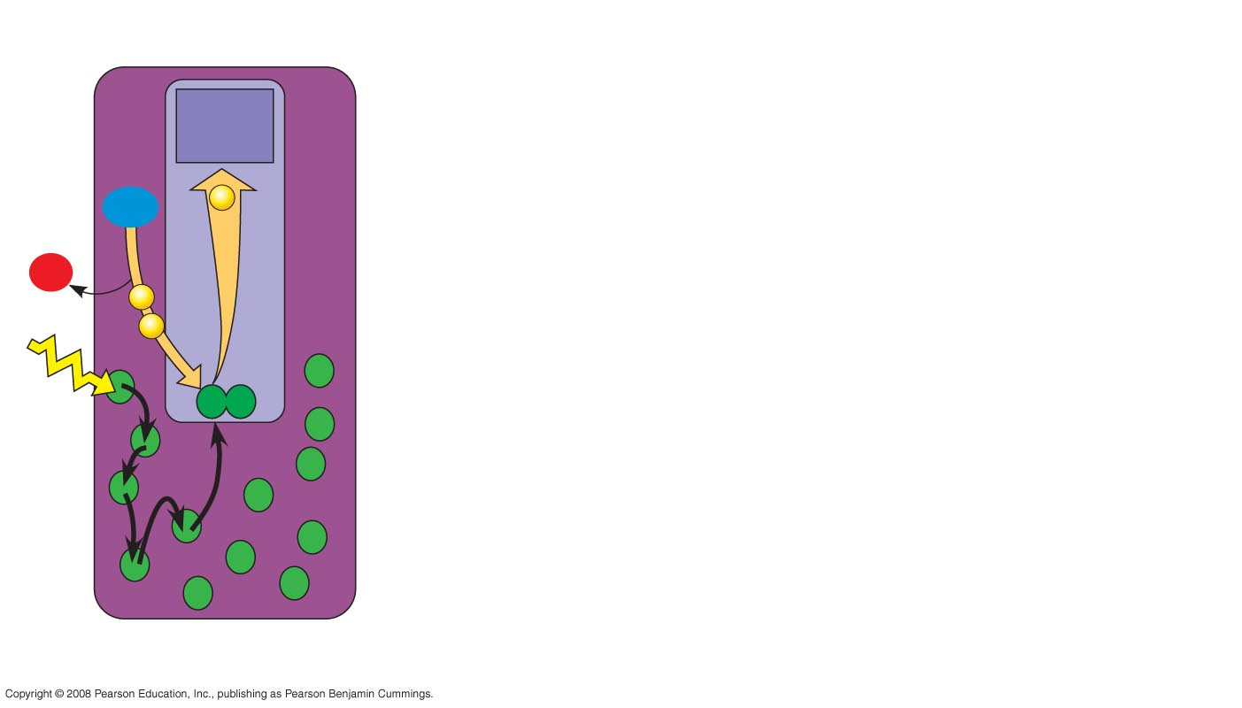
Fig. 10-13-2
Primary
acceptor
2
H₂O
e–
2 H⁺
+
3
¹/₂
O₂
e–
e–
P680
1
Light
Pigment
molecules
Photosystem II
(PS II)
Notes:
Figure 10.13 How linear electron flow during the light reactions generates ATP and NADPH

Slide 54
Each electron “falls” down an electron transport chain from the primary electron acceptor of PS II to PS I
Energy released by the fall drives the creation of a proton gradient across the thylakoid membrane
Diffusion of H⁺ (protons) across the membrane drives ATP synthesis
Copyright © 2008 Pearson Education, Inc., publishing as Pearson Benjamin Cummings

Slide 55
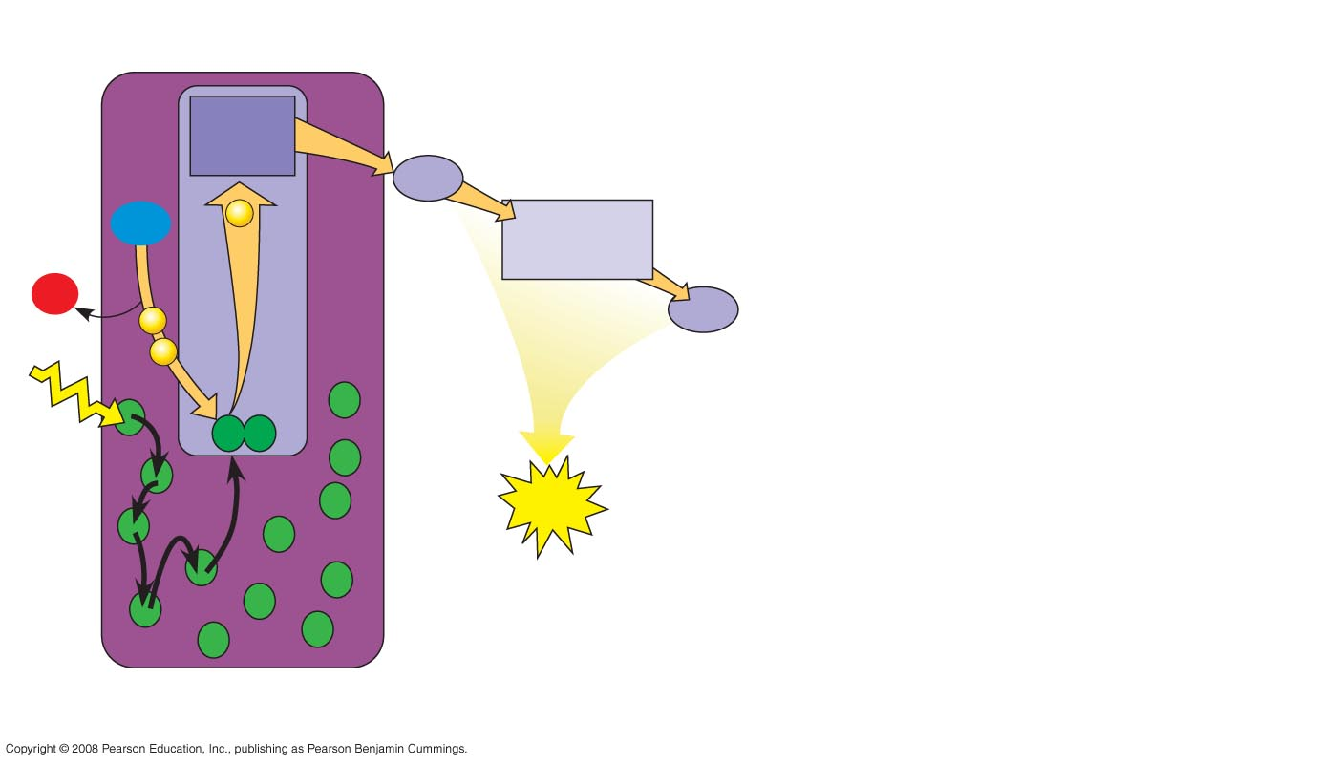
Fig. 10-13-3
Primary
acceptor
4
Electron transport chain
2
Pq
H₂O
e–
Cytochrome
complex
2 H⁺
+
3
¹/₂
O₂
Pc
e–
e–
P680
5
1
Light
ATP
Pigment
molecules
Photosystem II
(PS II)
Notes:
Figure 10.13 How linear electron flow during the light reactions generates ATP and NADPH

Slide 56
In PS I (like PS II), transferred light energy excites P700, which loses an electron to an electron acceptor
P700⁺ (P700 that is missing an electron) accepts an electron passed down from PS II via the electron transport chain
Copyright © 2008 Pearson Education, Inc., publishing as Pearson Benjamin Cummings

Slide 57
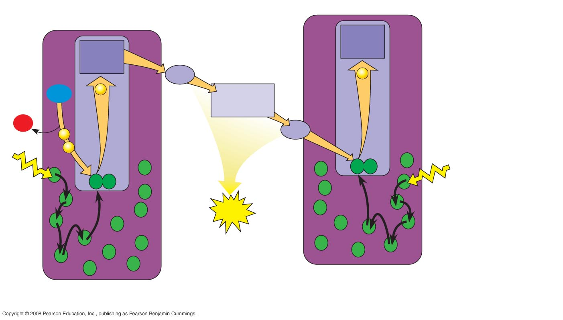
Fig. 10-13-4
Primary
acceptor
Primary
acceptor
4
Electron transport chain
e–
2
Pq
H₂O
e–
Cytochrome
complex
2 H⁺
+
3
¹/₂
O₂
Pc
e–
e–
P700
P680
5
Light
1
Light
6
ATP
Pigment
molecules
Photosystem I
(PS I)
Photosystem II
(PS II)
Notes:
Figure 10.13 How linear electron flow during the light reactions generates ATP and NADPH

Slide 58
Each electron “falls” down an electron transport chain from the primary electron acceptor of PS I to the protein ferredoxin (Fd)
The electrons are then transferred to NADP⁺ and reduce it to NADPH
The electrons of NADPH are available for the reactions of the Calvin cycle
Copyright © 2008 Pearson Education, Inc., publishing as Pearson Benjamin Cummings

Slide 59
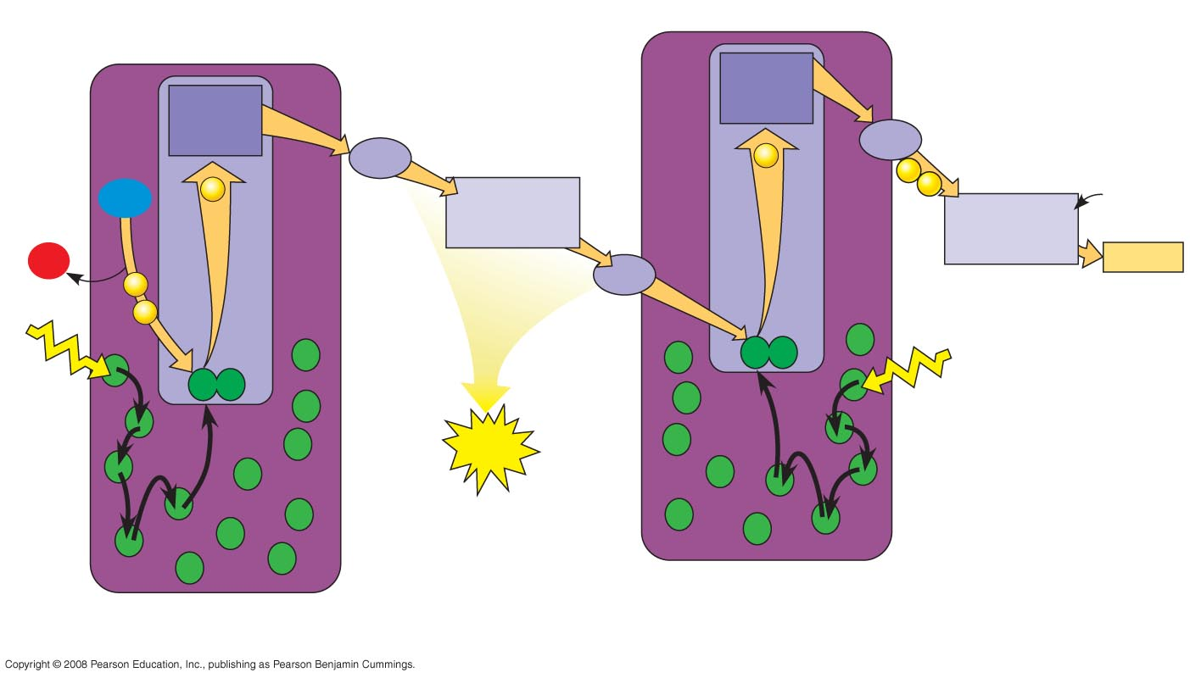
Fig. 10-13-5
Electron
transport
chain
Primary
acceptor
Primary
acceptor
4
7
Electron transport chain
e–
Fd
2
Pq
e–
8
H₂O
e–
Cytochrome
complex
e–
NADP⁺
+ H⁺
2 H⁺
NADP⁺
reductase
+
3
¹/₂
O₂
Pc
NADPH
e–
e–
P700
P680
5
Light
1
Light
6
6
ATP
Pigment
molecules
Photosystem I
(PS I)
Photosystem II
(PS II)
Notes:
Figure 10.13 How linear electron flow during the light reactions generates ATP and NADPH

Slide 60
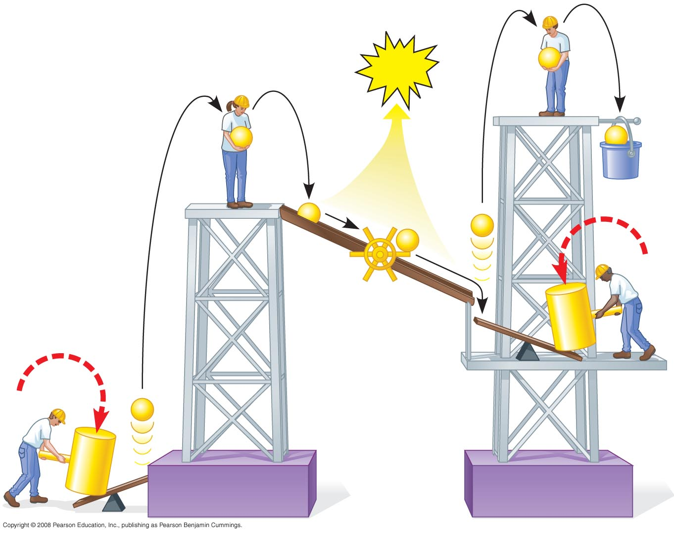
Fig. 10-14
ATP
e–
e–
e–
NADPH
e–
e–
e–
Mill
makes
ATP
Photon
e–
Photon
Photosystem II
Photosystem I
Notes:
Figure 10.14 A mechanical analogy for the light reactions

Slide 61
Cyclic Electron Flow
Cyclic electron flow uses only photosystem I and produces ATP, but not NADPH
Cyclic electron flow generates surplus ATP, satisfying the higher demand in the Calvin cycle
Copyright © 2008 Pearson Education, Inc., publishing as Pearson Benjamin Cummings

Slide 62
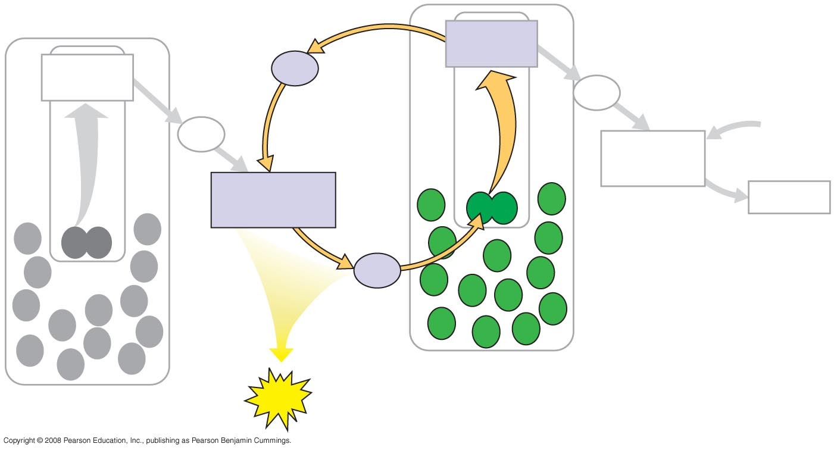
Fig. 10-15
Primary
acceptor
Primary
acceptor
Fd
Fd
Pq
NADP⁺
+ H⁺
NADP⁺
reductase
Cytochrome
complex
NADPH
Pc
Photosystem I
Photosystem II
ATP
Notes:
Figure 10.15 Cyclic electron flow

Slide 63
Some organisms such as purple sulfur bacteria have PS I but not PS II
Cyclic electron flow is thought to have evolved before linear electron flow
Cyclic electron flow may protect cells from light-induced damage
Copyright © 2008 Pearson Education, Inc., publishing as Pearson Benjamin Cummings

Slide 64
A Comparison of Chemiosmosis in Chloroplasts and Mitochondria
Chloroplasts and mitochondria generate ATP by chemiosmosis, but use different sources of energy
Mitochondria transfer chemical energy from food to ATP; chloroplasts transform light energy into the chemical energy of ATP
Spatial organization of chemiosmosis differs between chloroplasts and mitochondria but also shows similarities
Copyright © 2008 Pearson Education, Inc., publishing as Pearson Benjamin Cummings

Slide 65
In mitochondria, protons are pumped to the intermembrane space and drive ATP synthesis as they diffuse back into the mitochondrial matrix
In chloroplasts, protons are pumped into the thylakoid space and drive ATP synthesis as they diffuse back into the stroma
Copyright © 2008 Pearson Education, Inc., publishing as Pearson Benjamin Cummings

Slide 66
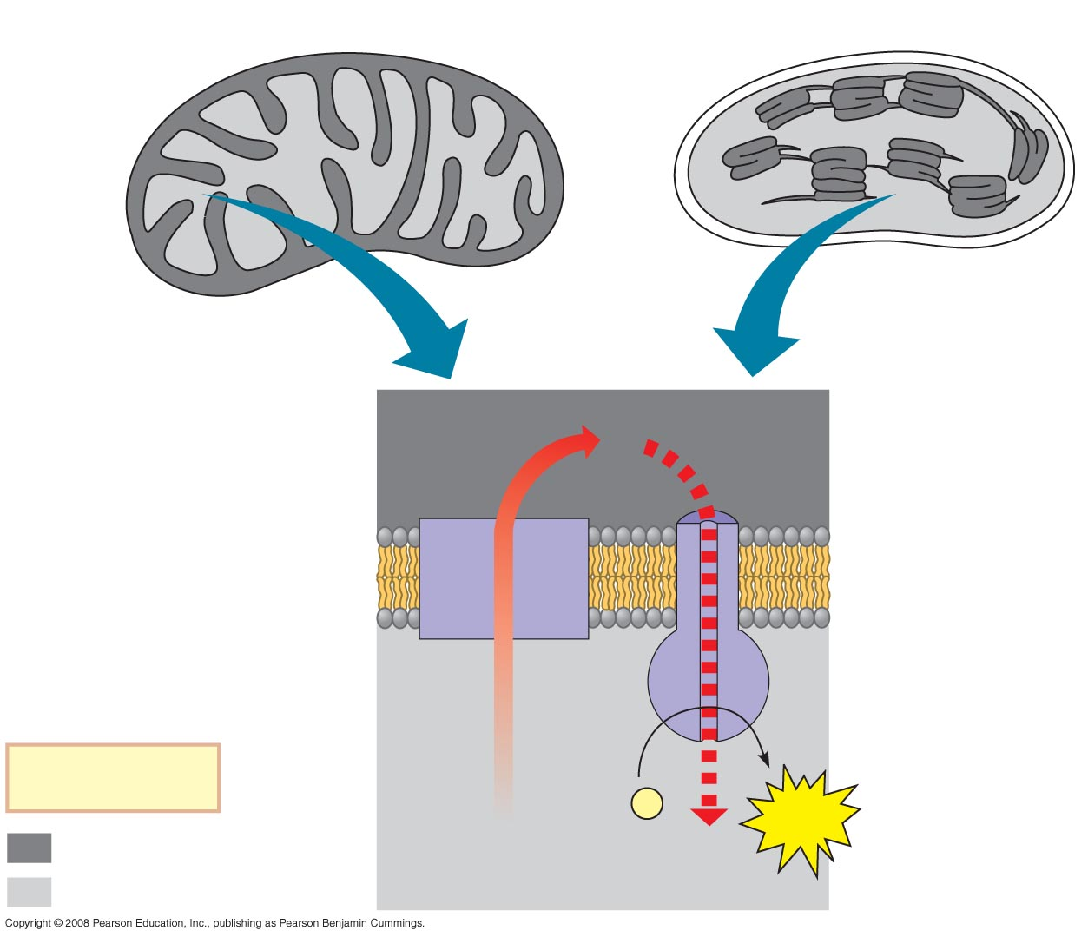
Fig. 10-16
Mitochondrion
Chloroplast
MITOCHONDRION
STRUCTURE
CHLOROPLAST
STRUCTURE
Intermembrane
space
H⁺
Diffusion
Thylakoid
space
Inner
membrane
Electron
transport
chain
Thylakoid
membrane
ATP
synthase
Matrix
Stroma
Key
ADP + P
i
ATP
Higher [H⁺]
H⁺
Lower [H⁺]
Notes:
Figure 10.16 Comparison of chemiosmosis in mitochondria and chloroplasts

Slide 67
ATP and NADPH are produced on the side facing the stroma, where the Calvin cycle takes place
In summary, light reactions generate ATP and increase the potential energy of electrons by moving them from H₂O to NADPH
Copyright © 2008 Pearson Education, Inc., publishing as Pearson Benjamin Cummings

Slide 68
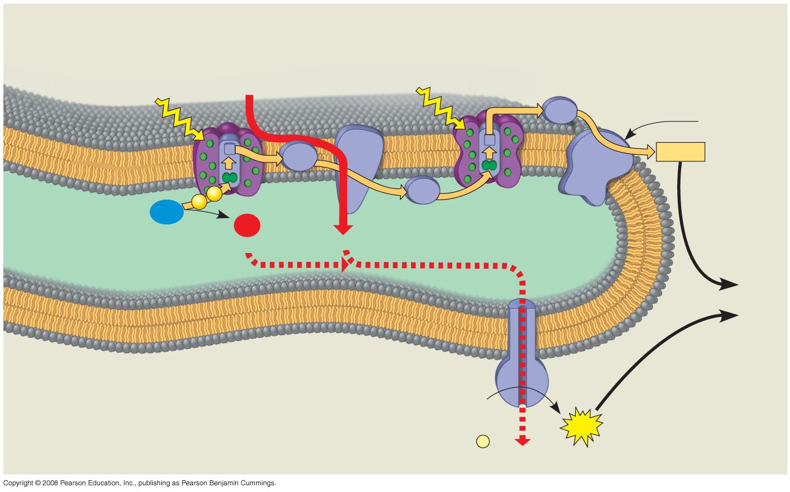
Fig. 10-17
STROMA
(low H⁺ concentration)
Photosystem II
Cytochrome
complex
Photosystem I
Light
4 H⁺
Light
NADP⁺
reductase
Fd
3
NADP⁺ + H⁺
Pq
NADPH
e–
e–
2
Pc
H₂O
O₂
THYLAKOID SPACE
(high H⁺ concentration)
1
¹/₂
+2 H⁺
4 H⁺
To
Calvin
Cycle
Thylakoid
membrane
ATP
synthase
STROMA
(low H⁺ concentration)
ADP
+
ATP
P
i
H⁺
Notes:
Figure 10.17 The light reactions and chemiosmosis: the organization of the thylakoid membrane

Slide 69
Concept 10.3: The Calvin cycle uses ATP and NADPH to convert CO₂ to sugar
The Calvin cycle, like the citric acid cycle, regenerates its starting material after molecules enter and leave the cycle
The cycle builds sugar from smaller molecules by using ATP and the reducing power of electrons carried by NADPH
Copyright © 2008 Pearson Education, Inc., publishing as Pearson Benjamin Cummings

Slide 70
Carbon enters the cycle as CO₂ and leaves as a sugar named glyceraldehyde-3-phospate (G3P)
For net synthesis of 1 G3P, the cycle must take place three times, fixing 3 molecules of CO₂
The Calvin cycle has three phases:
Carbon fixation (catalyzed by rubisco)
Reduction
Regeneration of the CO₂ acceptor (RuBP)
Copyright © 2008 Pearson Education, Inc., publishing as Pearson Benjamin Cummings

Slide 71
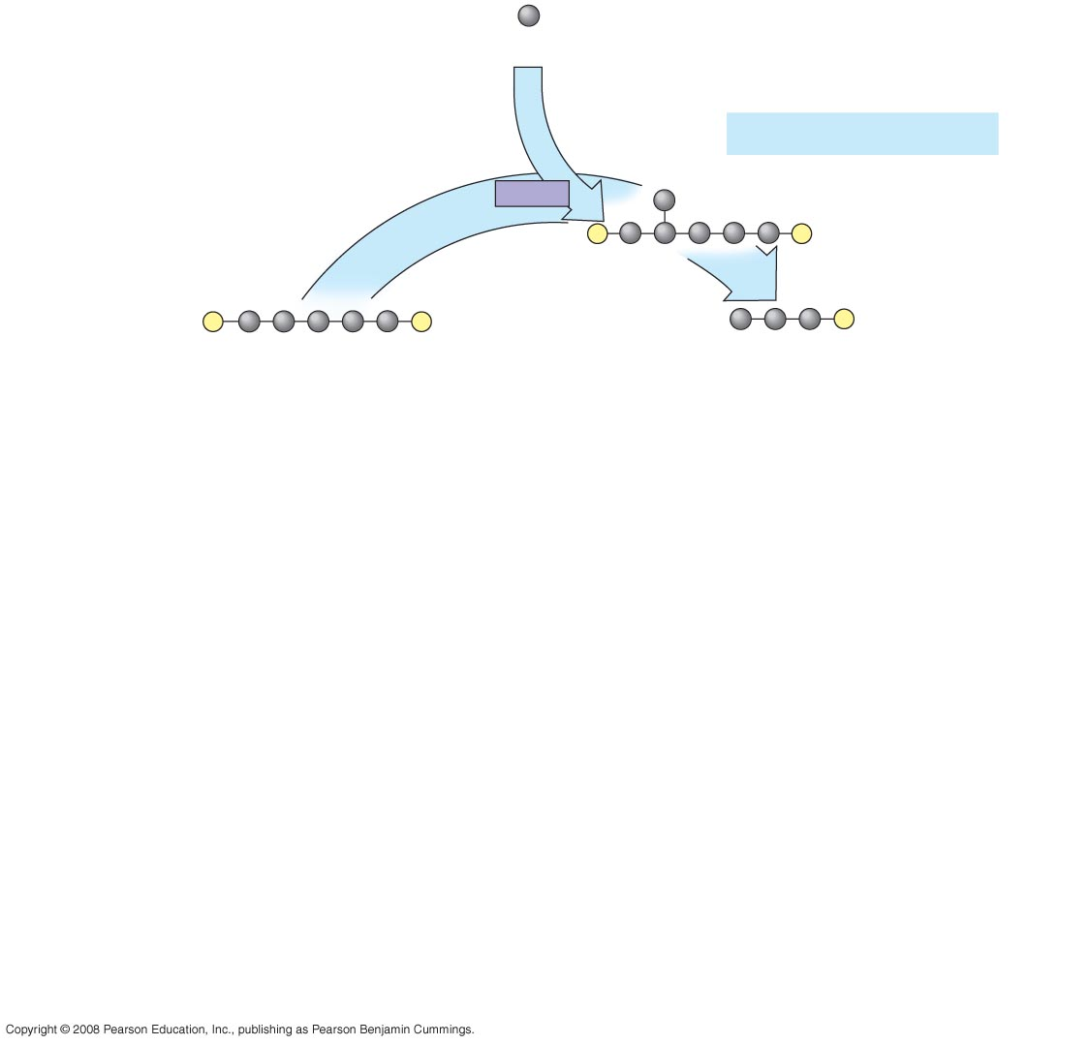
Fig. 10-18-1
Input
3
(Entering one
at a time)
CO₂
Phase 1: Carbon fixation
Rubisco
3
P
P
Short-lived
intermediate
3
P
P
6
P
Ribulose bisphosphate
(RuBP)
3-Phosphoglycerate
Notes:
Figure 10.18 The Calvin cycle

Slide 72
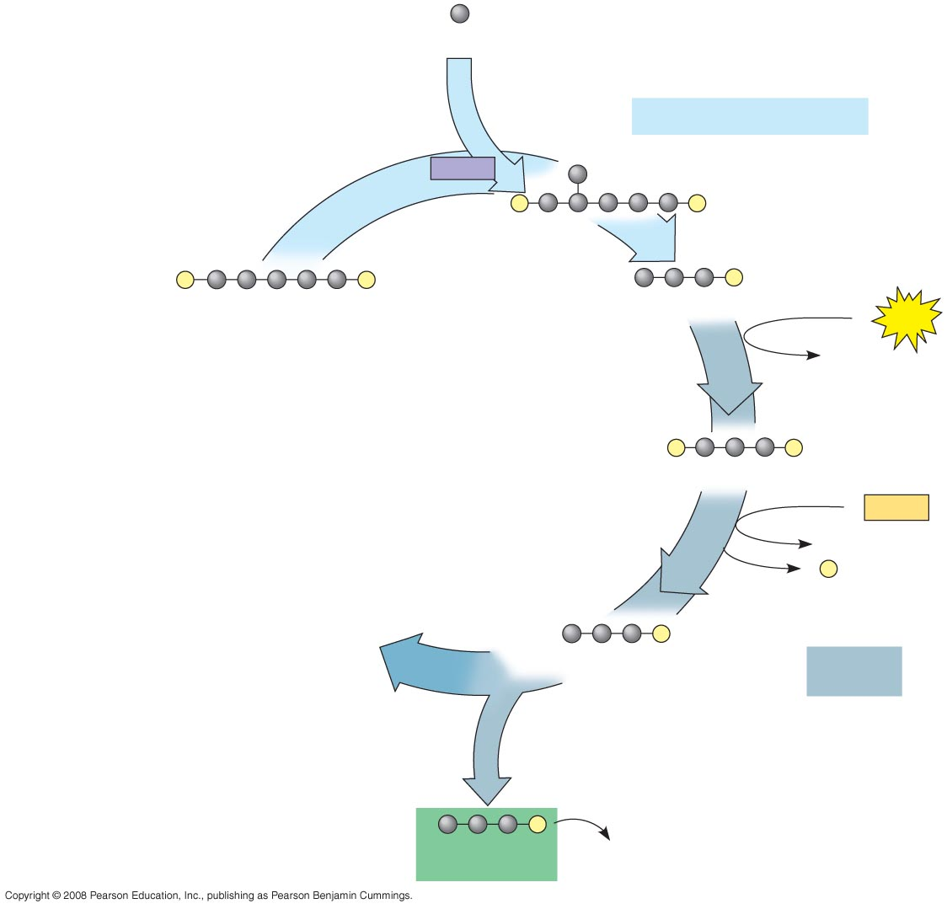
Fig. 10-18-2
Input
3
(Entering one
at a time)
CO₂
Phase 1: Carbon fixation
Rubisco
3
P
P
Short-lived
intermediate
3
P
P
6
P
Ribulose bisphosphate
(RuBP)
3-Phosphoglycerate
6
ATP
6 ADP
Calvin
Cycle
6
P
P
1,3-Bisphosphoglycerate
6
NADPH
6 NADP⁺
6
P
i
6
P
Glyceraldehyde-3-phosphate
(G3P)
Phase 2:
Reduction
1
P
Glucose and
other organic
compounds
Output
G3P
(a sugar)
Notes:
Figure 10.18 The Calvin cycle

Slide 73
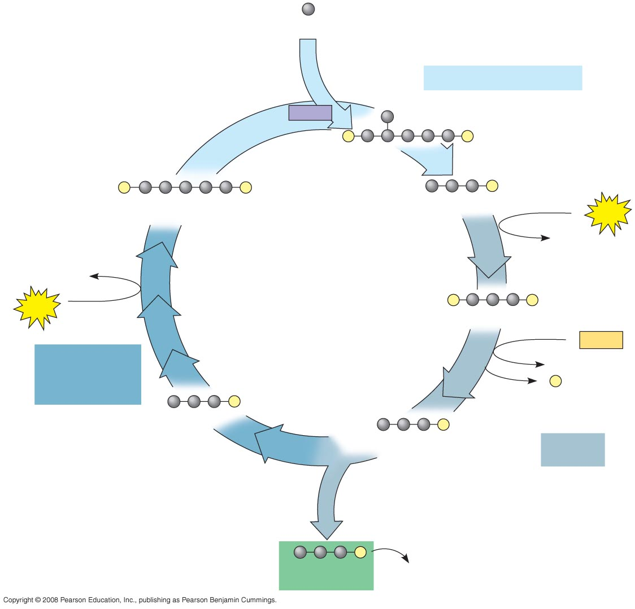
Fig. 10-18-3
Input
3
(Entering one
at a time)
CO₂
Phase 1: Carbon fixation
Rubisco
3
P
P
Short-lived
intermediate
3
P
P
6
P
Ribulose bisphosphate
(RuBP)
3-Phosphoglycerate
6
ATP
6 ADP
3 ADP
Calvin
Cycle
3
ATP
6
P
P
1,3-Bisphosphoglycerate
6
NADPH
Phase 3:
Regeneration of
the CO₂ acceptor
(RuBP)
6 NADP⁺
6
P
i
5
P
G3P
6
P
Glyceraldehyde-3-phosphate
(G3P)
Phase 2:
Reduction
1
P
Glucose and
other organic
compounds
Output
G3P
(a sugar)
Notes:
Figure 10.18 The Calvin cycle

Slide 74
Concept 10.4: Alternative mechanisms of carbon fixation have evolved in hot, arid climates
Dehydration is a problem for plants, sometimes requiring trade-offs with other metabolic processes, especially photosynthesis
On hot, dry days, plants close stomata, which conserves H₂O but also limits photosynthesis
The closing of stomata reduces access to CO₂ and causes O₂ to build up
These conditions favor a seemingly wasteful process called photorespiration
Copyright © 2008 Pearson Education, Inc., publishing as Pearson Benjamin Cummings

Slide 75
Photorespiration: An Evolutionary Relic?
In most plants (C₃ plants), initial fixation of CO₂, via rubisco, forms a three-carbon compound
In photorespiration, rubisco adds O₂ instead of CO₂ in the Calvin cycle
Photorespiration consumes O₂ and organic fuel and releases CO₂ without producing ATP or sugar
Copyright © 2008 Pearson Education, Inc., publishing as Pearson Benjamin Cummings

Slide 76
Photorespiration may be an evolutionary relic because rubisco first evolved at a time when the atmosphere had far less O₂ and more CO₂
Photorespiration limits damaging products of light reactions that build up in the absence of the Calvin cycle
In many plants, photorespiration is a problem because on a hot, dry day it can drain as much as 50% of the carbon fixed by the Calvin cycle
Copyright © 2008 Pearson Education, Inc., publishing as Pearson Benjamin Cummings

Slide 77
C₄ Plants
C₄ plants minimize the cost of photorespiration by incorporating CO₂ into four-carbon compounds in mesophyll cells
This step requires the enzyme PEP carboxylase
PEP carboxylase has a higher affinity for CO₂ than rubisco does; it can fix CO₂ even when CO₂ concentrations are low
These four-carbon compounds are exported to bundle-sheath cells, where they release CO₂ that is then used in the Calvin cycle
Copyright © 2008 Pearson Education, Inc., publishing as Pearson Benjamin Cummings

Slide 78
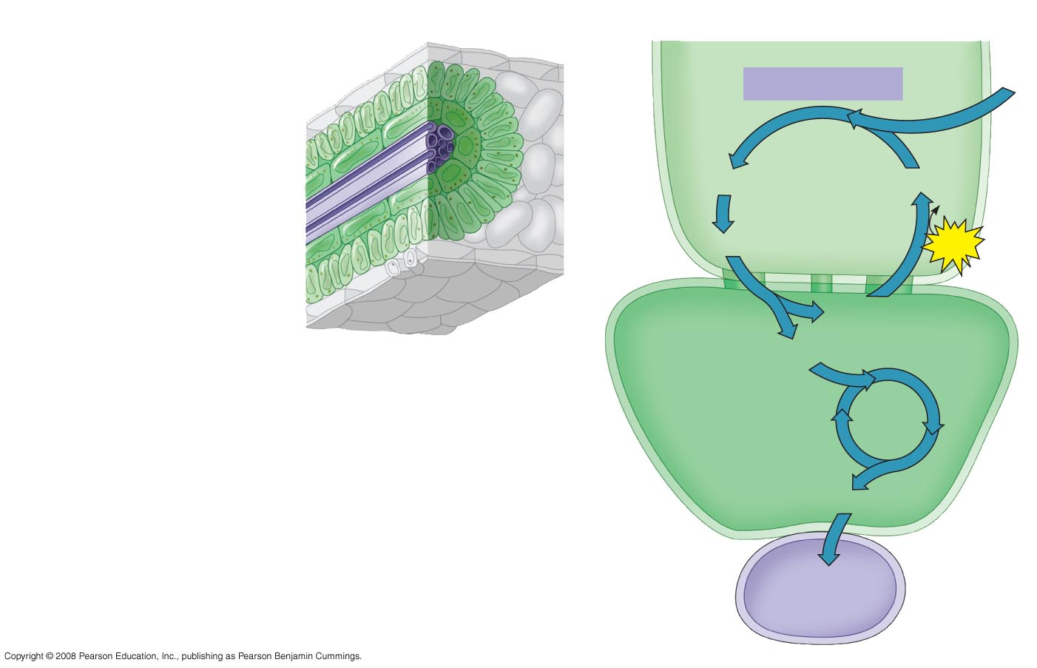
Fig. 10-19
C₄ leaf anatomy
The C₄ pathway
Mesophyll
cell
Mesophyll cell
PEP carboxylase
CO₂
Photosynthetic
cells of C₄
plant leaf
Bundle-
sheath
cell
Oxaloacetate (4C)
PEP (3C)
Vein
(vascular tissue)
ADP
Malate (4C)
ATP
Bundle-
sheath
cell
Pyruvate (3C)
Stoma
CO₂
Calvin
Cycle
Sugar
Vascular
tissue
Notes:
Figure 10.19 C₄ leaf anatomy and the C₄ pathway

Slide 79
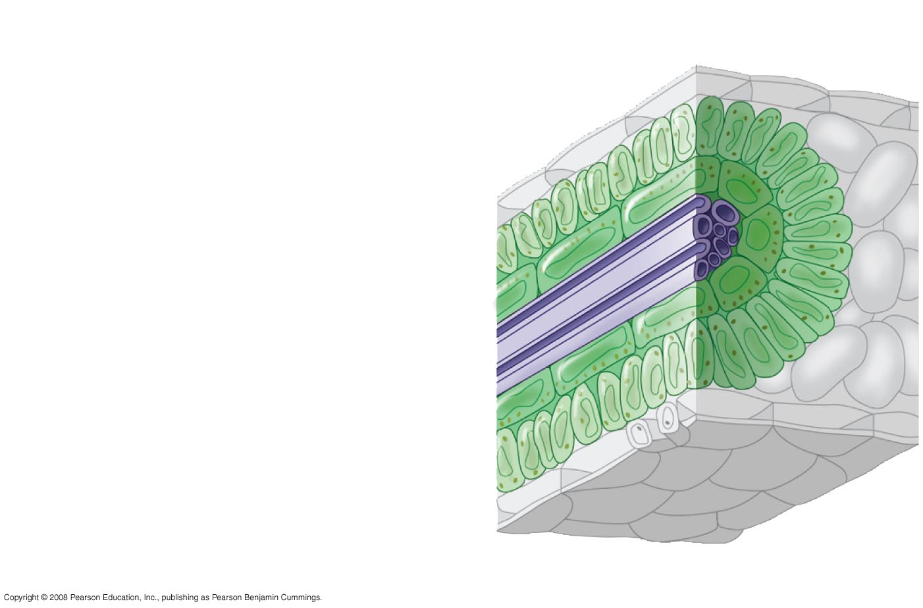
Fig. 10-19a
C₄ leaf anatomy
Mesophyll cell
Photosynthetic
cells of C₄
plant leaf
Bundle-
sheath
cell
Vein
(vascular tissue)
Stoma
Notes:
Figure 10.19 C₄ leaf anatomy and the C₄ pathway

Slide 80
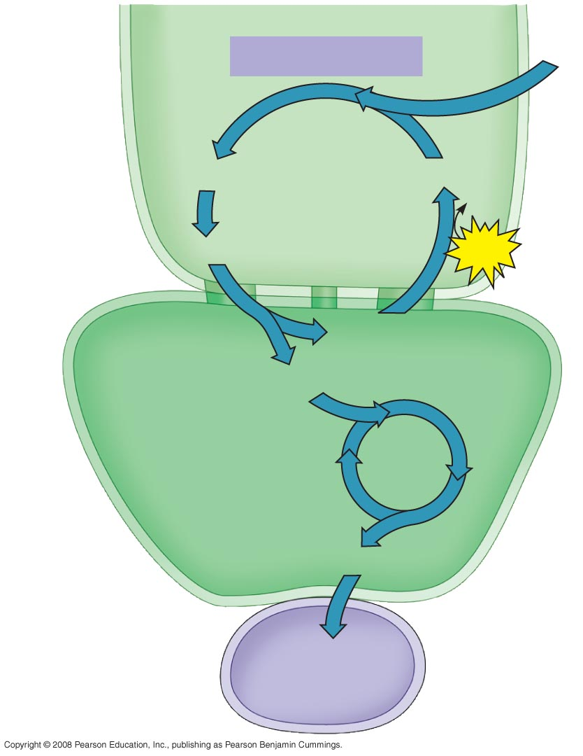
Fig. 10-19b
The C₄
pathway
Mesophyll
cell
PEP carboxylase
CO₂
Oxaloacetate (4C)
PEP (3C)
ADP
Malate (4C)
ATP
Pyruvate (3C)
Bundle-
sheath
cell
CO₂
Calvin
Cycle
Sugar
Vascular
tissue
Notes:
Figure 10.19 C₄ leaf anatomy and the C₄ pathway

Slide 81
CAM Plants
Some plants, including succulents, use crassulacean acid metabolism (CAM) to fix carbon
CAM plants open their stomata at night, incorporating CO₂ into organic acids
Stomata close during the day, and CO₂ is released from organic acids and used in the Calvin cycle
Copyright © 2008 Pearson Education, Inc., publishing as Pearson Benjamin Cummings

Slide 82
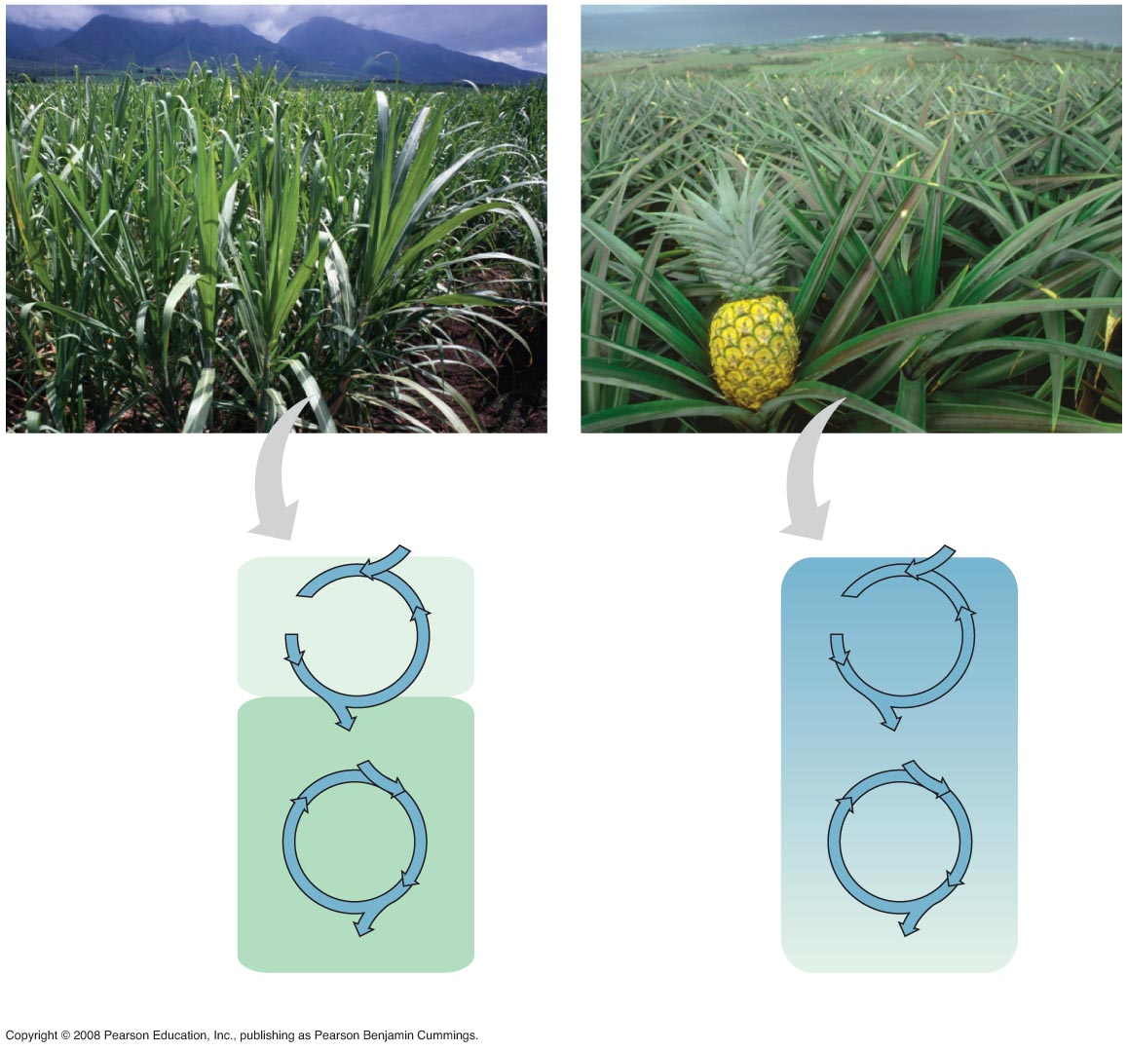
Fig. 10-20
Sugarcane
C₄
Pineapple
CAM
CO₂
CO₂
Mesophyll
cell
1
CO₂ incorporated
into four-carbon
organic acids
(carbon fixation)
Night
Organic acid
Organic acid
Bundle-
sheath
cell
CO₂
CO₂
Day
Calvin
Cycle
2
Organic acids
release CO₂ to
Calvin cycle
Calvin
Cycle
Sugar
Sugar
(a) Spatial separation of steps
(b) Temporal separation of steps
Notes:
Figure 10.20 C₄ and CAM photosynthesis compared

Slide 83
The Importance of Photosynthesis: A Review
The energy entering chloroplasts as sunlight gets stored as chemical energy in organic compounds
Sugar made in the chloroplasts supplies chemical energy and carbon skeletons to synthesize the organic molecules of cells
Plants store excess sugar as starch in structures such as roots, tubers, seeds, and fruits
In addition to food production, photosynthesis produces the O₂ in our atmosphere
Copyright © 2008 Pearson Education, Inc., publishing as Pearson Benjamin Cummings

Slide 84
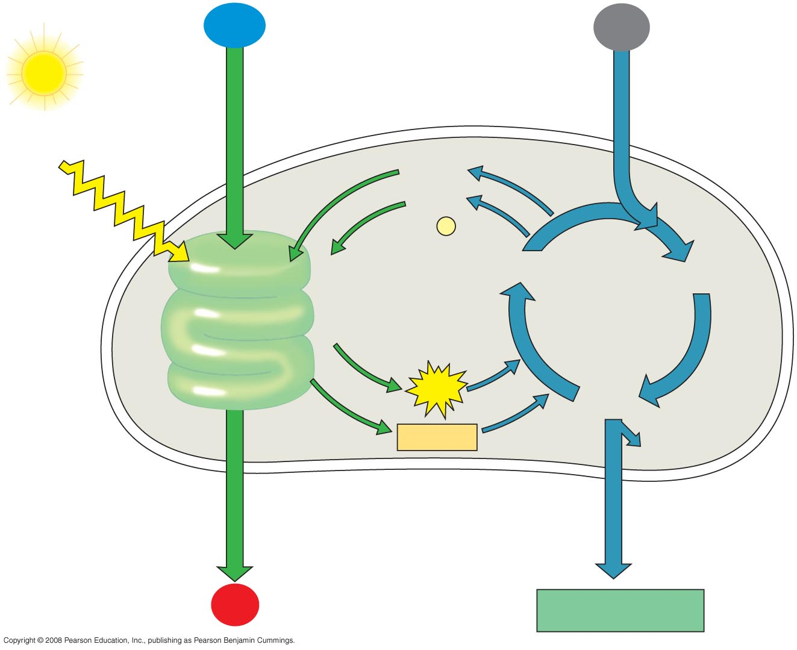
Fig. 10-21
H₂O
CO₂
Light
NADP⁺
ADP
+
P
i
Light
Reactions:
Photosystem II
Electron transport chain
Photosystem I
Electron transport chain
RuBP
3-Phosphoglycerate
Calvin
Cycle
ATP
G3P
NADPH
Starch
(storage)
Chloroplast
O₂
Sucrose (export)
Notes:
Figure 10.21 A review of photosynthesis

Slide 85
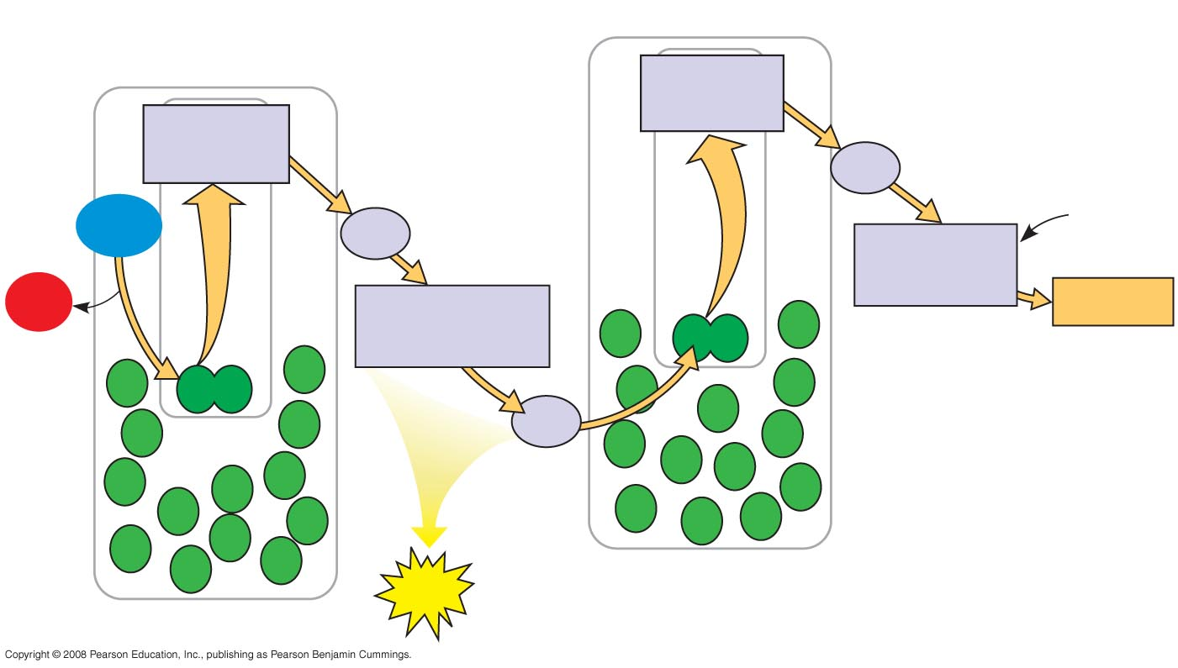
Fig. 10-UN1
H₂O
CO₂
Primary
acceptor
Electron transport
chain
Primary
acceptor
Electron transport
chain
Fd
H₂O
NADP⁺
+ H⁺
Pq
NADP⁺
reductase
O₂
Cytochrome
complex
NADPH
Pc
Photosystem I
ATP
Photosystem II
O₂

Slide 86
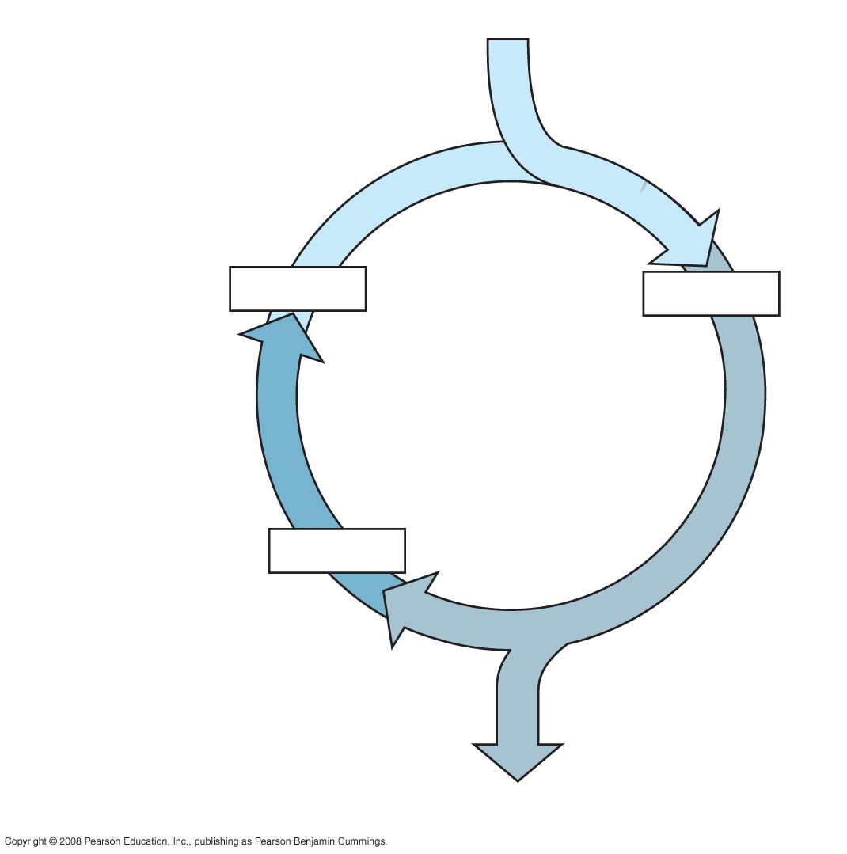
Fig. 10-UN2
3 CO₂
Carbon fixation
3 × 5C
6 × 3C
Calvin
Cycle
Regeneration of
CO₂ acceptor
5 × 3C
Reduction
1 G3P (3C)

Slide 87
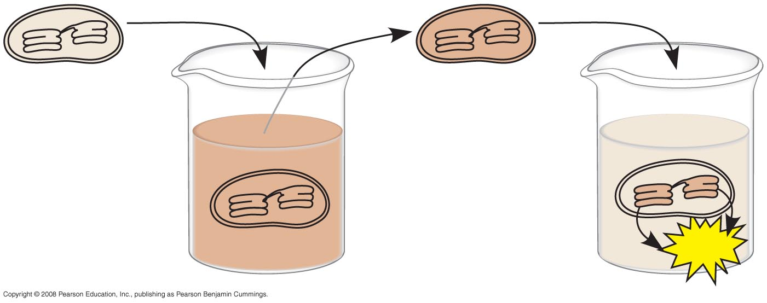
Fig. 10-UN3
pH 7
pH 4
pH 4
pH 8
ATP

Slide 88
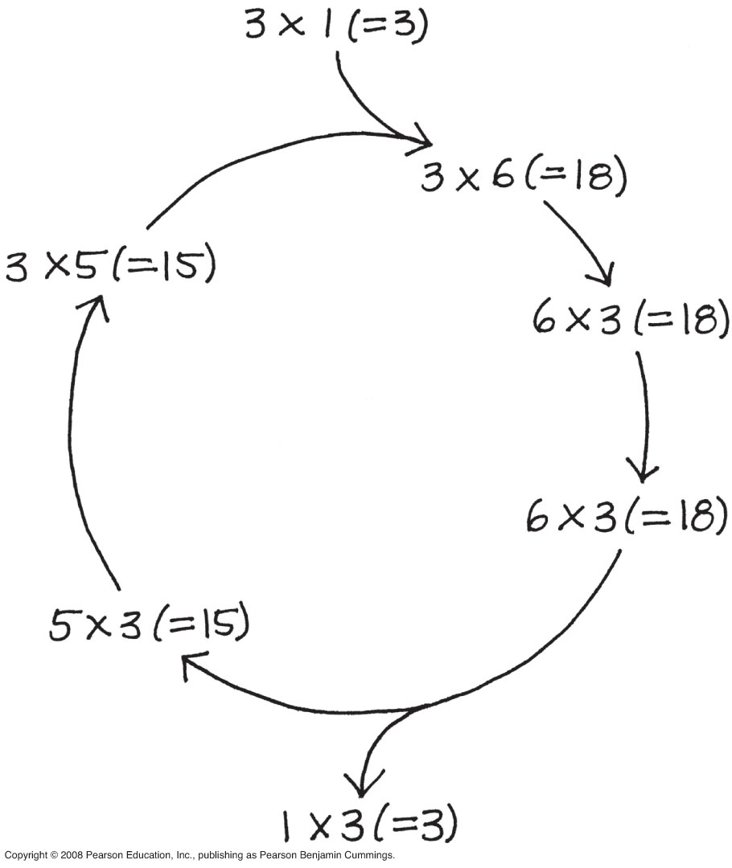
Fig. 10-UN4

Slide 89
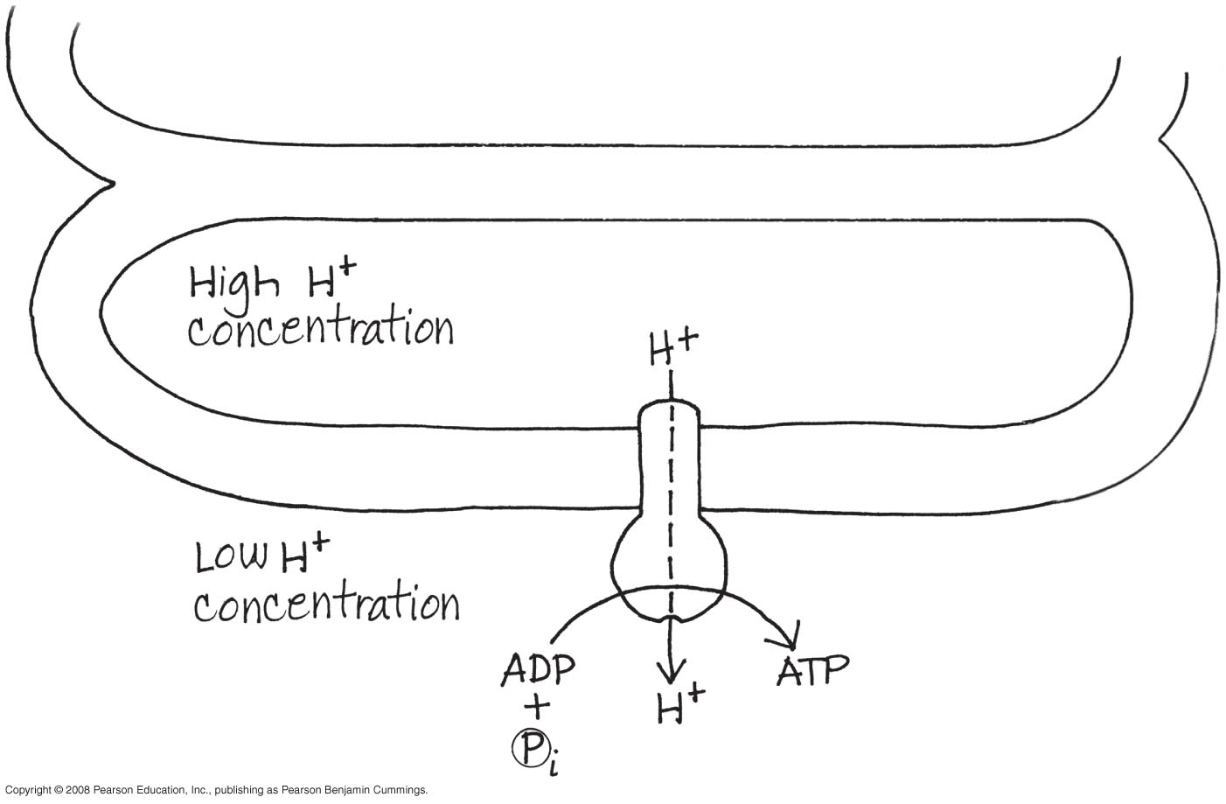
Fig. 10-UN5

Slide 90
You should now be able to:
Describe the structure of a chloroplast
Describe the relationship between an action spectrum and an absorption spectrum
Trace the movement of electrons in linear electron flow
Trace the movement of electrons in cyclic electron flow
Copyright © 2008 Pearson Education, Inc., publishing as Pearson Benjamin Cummings

Slide 91
Describe the similarities and differences between oxidative phosphorylation in mitochondria and photophosphorylation in chloroplasts
Describe the role of ATP and NADPH in the Calvin cycle
Describe the major consequences of photorespiration
Describe two important photosynthetic adaptations that minimize photorespiration
Copyright © 2008 Pearson Education, Inc., publishing as Pearson Benjamin Cummings

